Slide 1
Azure DevOps Pipeline for Docker Web Apps User Guide
2023

Slide 2
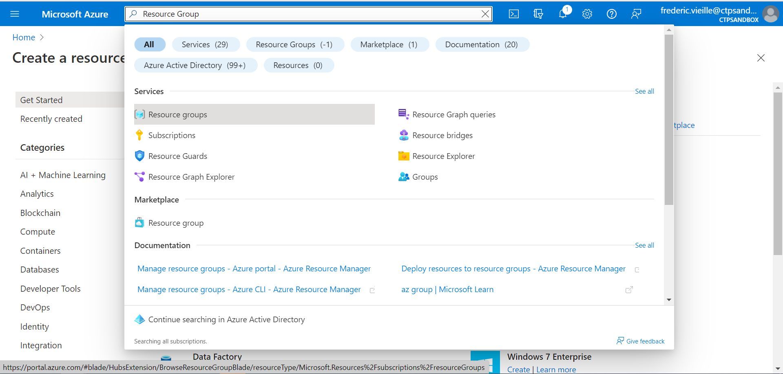
1- Create a Resource group
In order to structure our resources in a same environment we will create a resource group.
Select Resource groups in the search bar

Slide 3
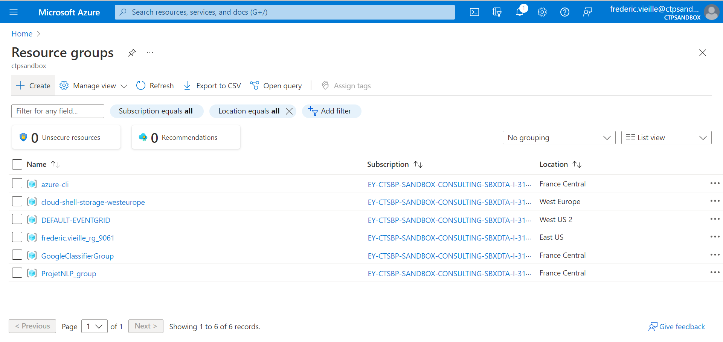
1- Create a Resource group
Select + Create

Slide 4
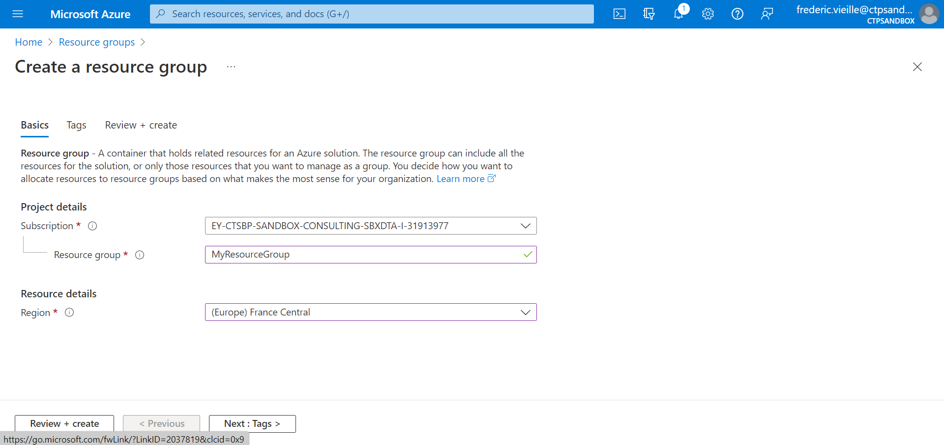
1- Create a Resource group
Select your Azure Subscription
Enter a resource group name
Choose the closest region

Slide 5
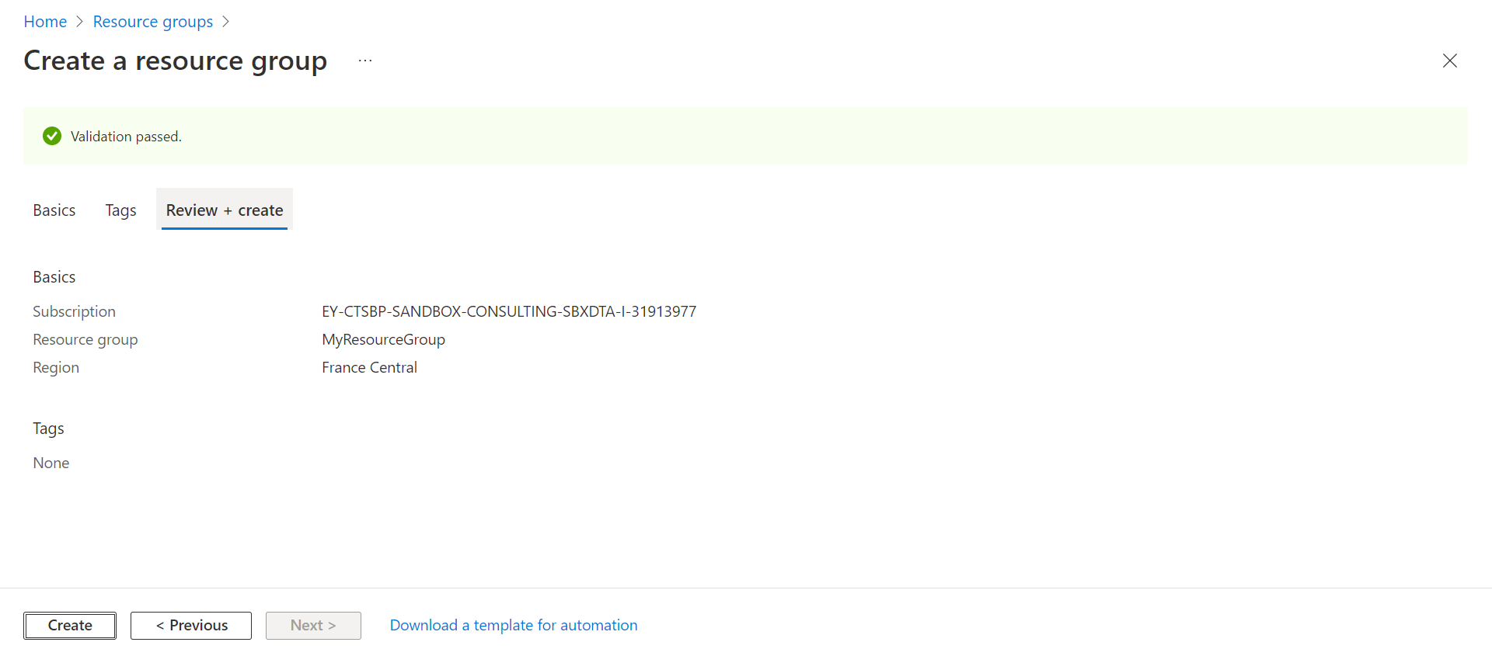
1- Create a Resource group
Select Create

Slide 6
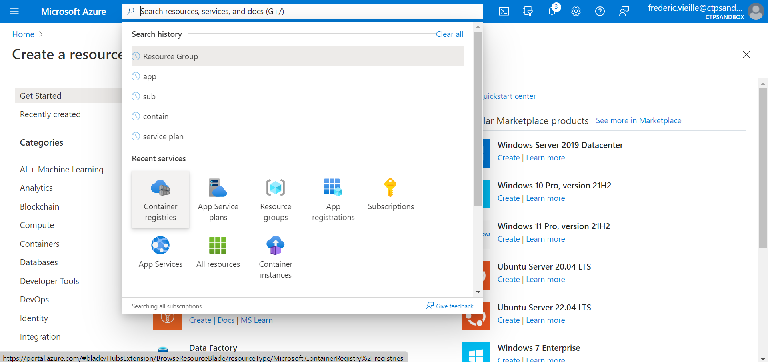
2- Create a Container registry
In order to store your docker image from our DevOps repo, we need to create a Container registry.
Select Container registries in the search bar

Slide 7
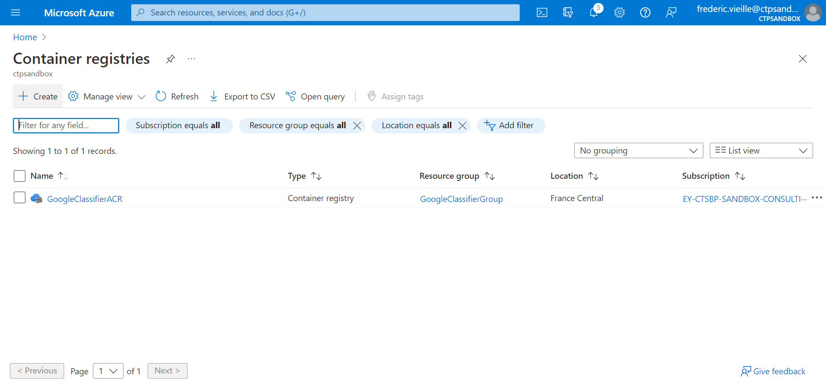
2- Create a Container registry
Select + Create

Slide 8
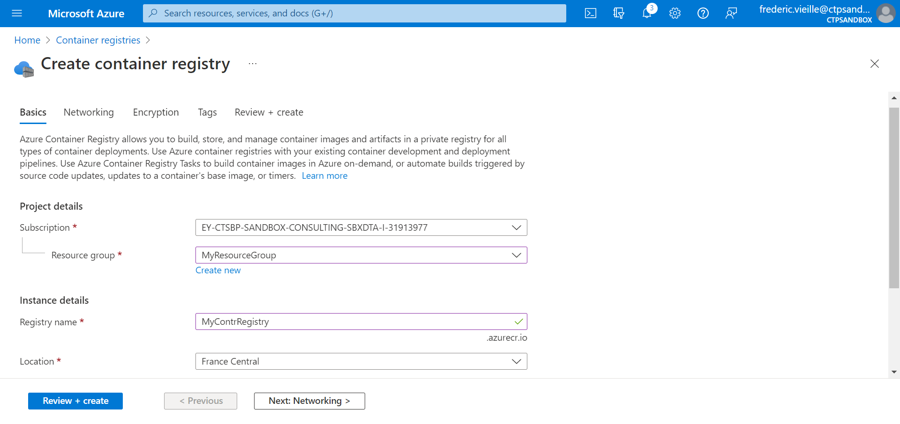
2- Create a Container registry
Select your Azure subscription
Select your previously created resource group
Enter a Registry name
Choose the closest location for your container registry

Slide 9
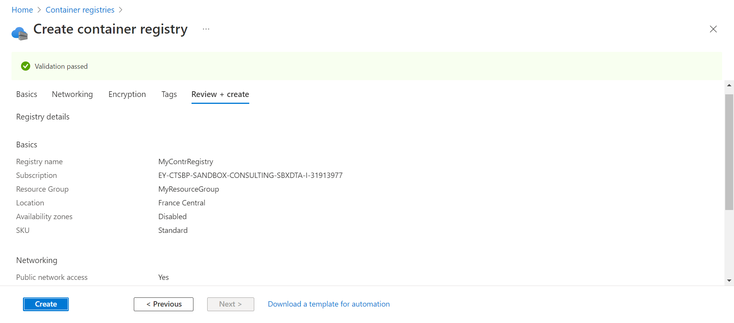
2- Create a Container registry
Select Create

Slide 10
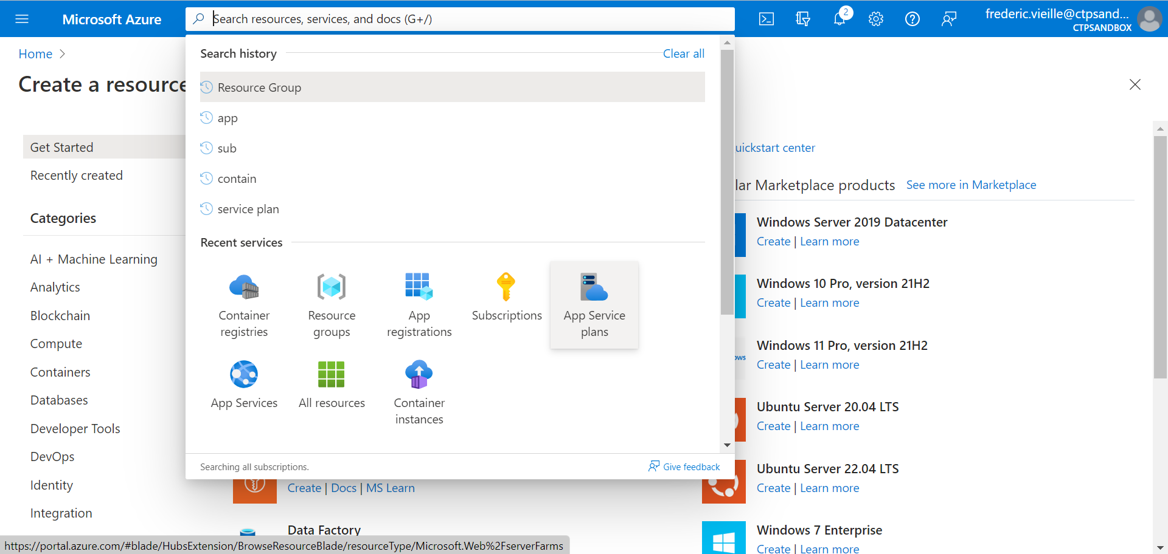
3- Create an App Service plan
In order to run your new web application, we need to create a machine service plan.
Select App Service plans in the search bar

Slide 11
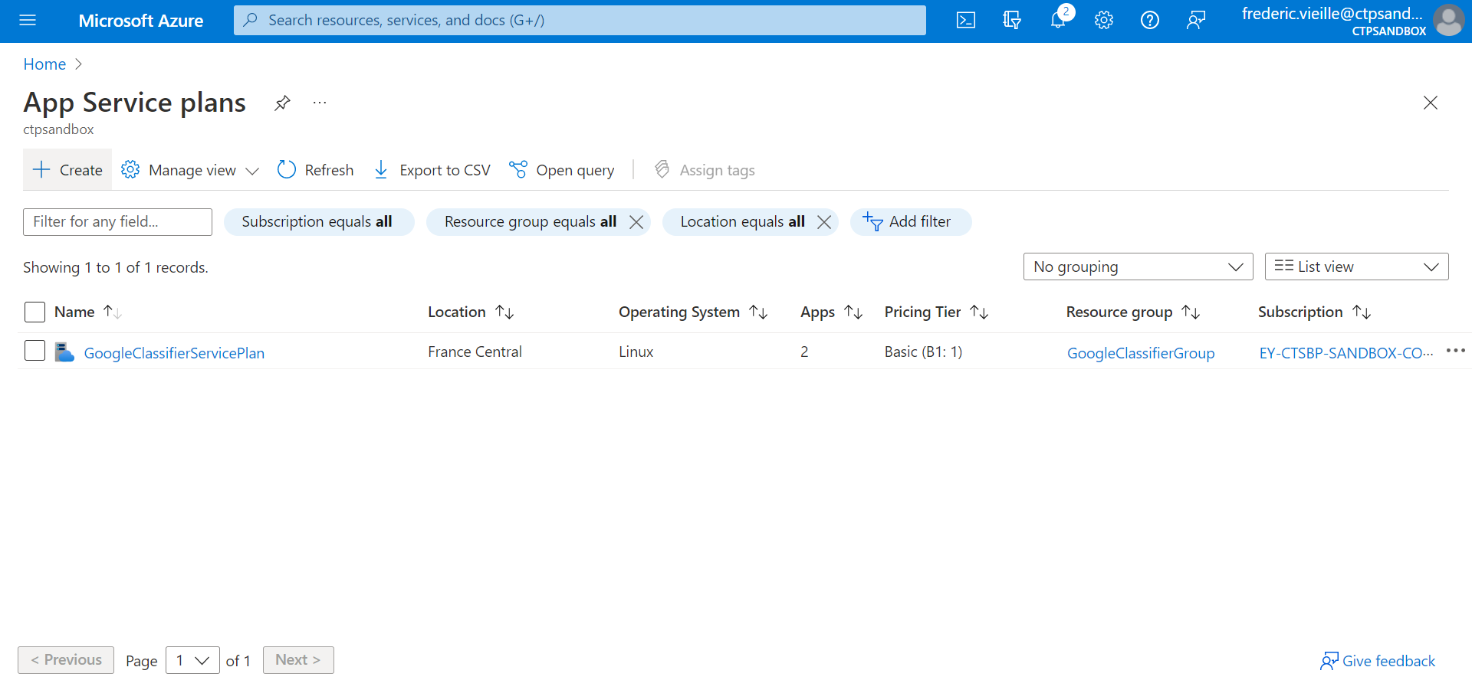
3- Create an App Service plan
Select + Create

Slide 12
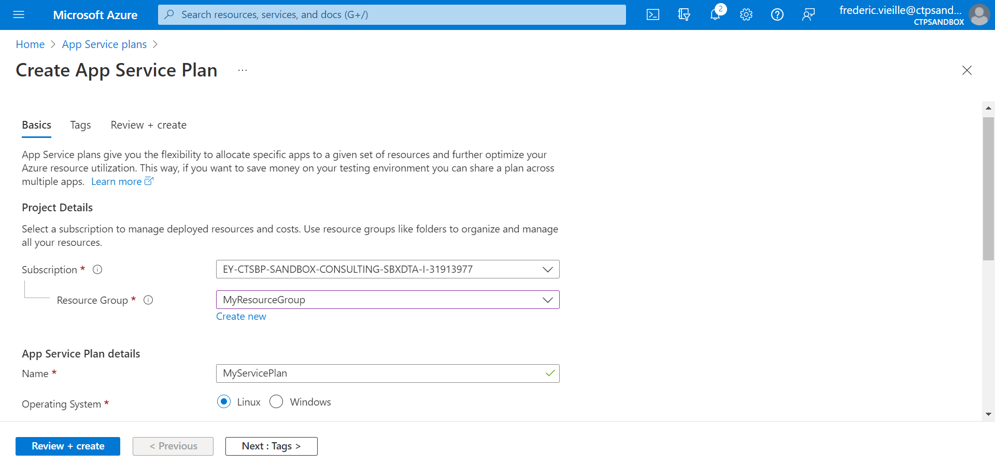
3- Create an App Service plan
Select your Azure Subscription
Select our previously created Resource Group
Enter a name for your App Service Plan

Slide 13
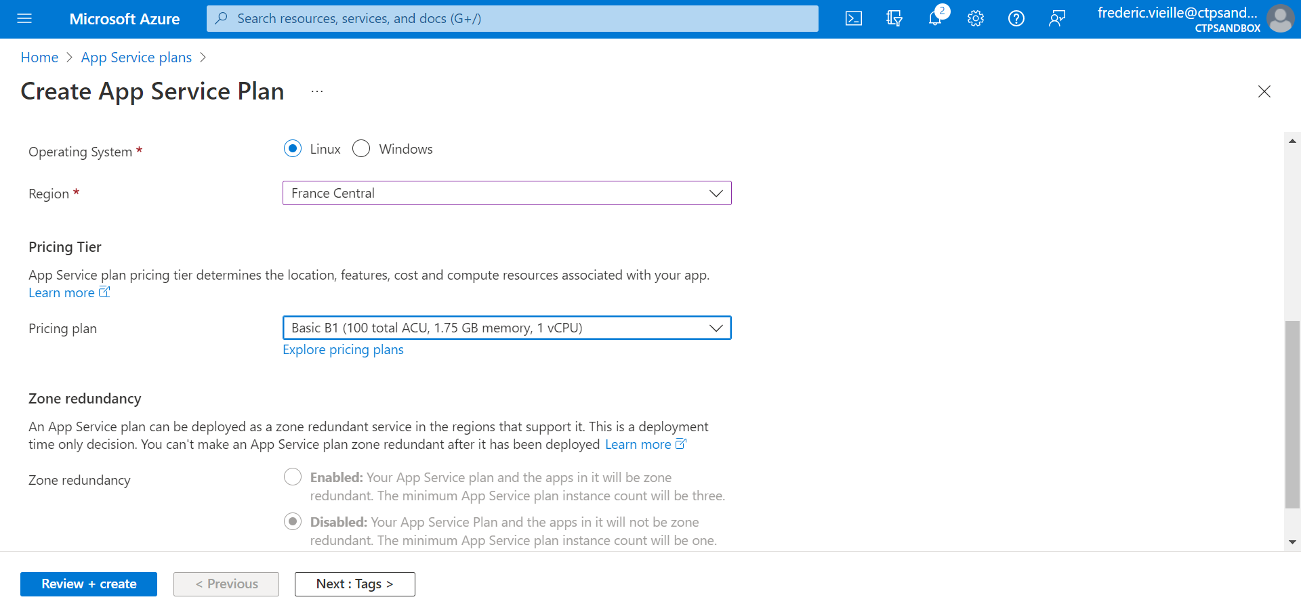
3- Create an App Service plan
Choose the Linux option for Operating System
Select the closest region
Choose a Pricing plan (adapt your pricing plan according to your needs by exploring in the Explore pricing plans link)

Slide 14
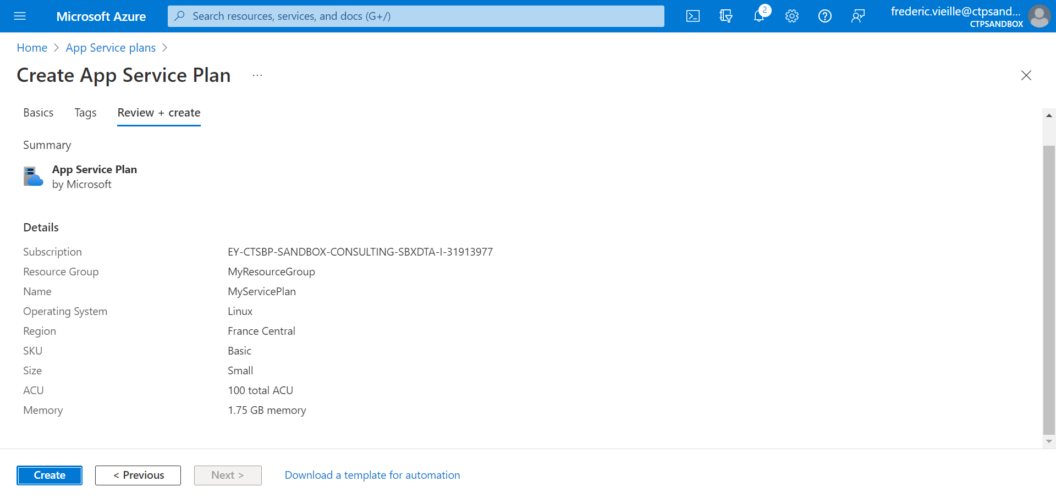
3- Create an App Service plan
Select Create

Slide 15
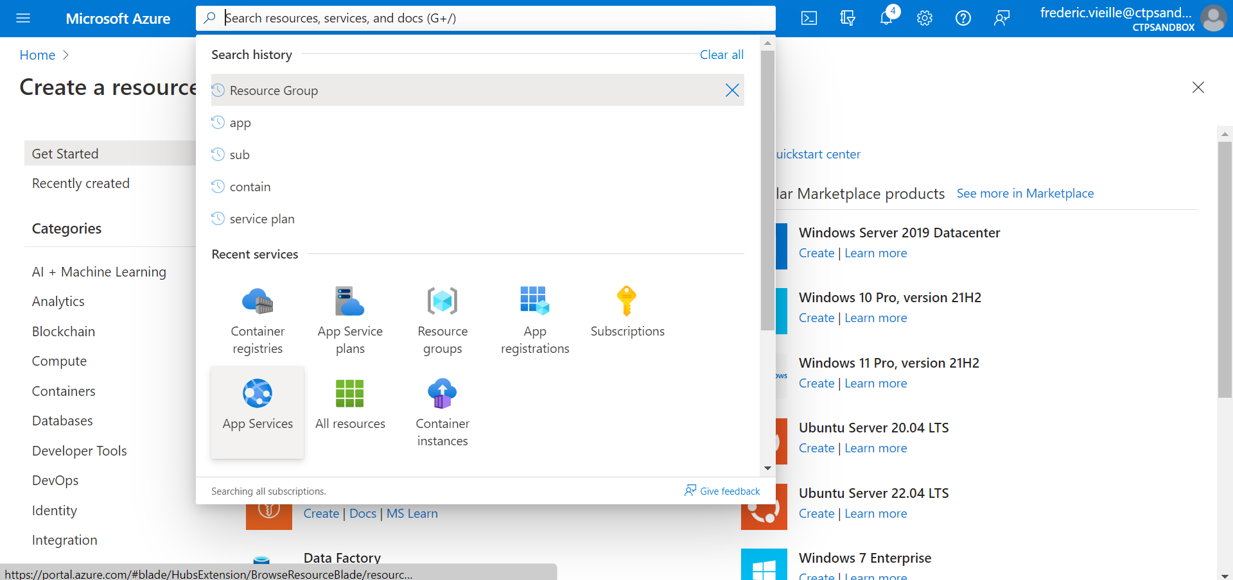
4- Create a Web App
Finally, we can create our App Service. Before using our Docker image from your DevOps repo, we will create a QuickStart Microsoft app and update it later with our DevOps Pipeline.
Select App Services

Slide 16
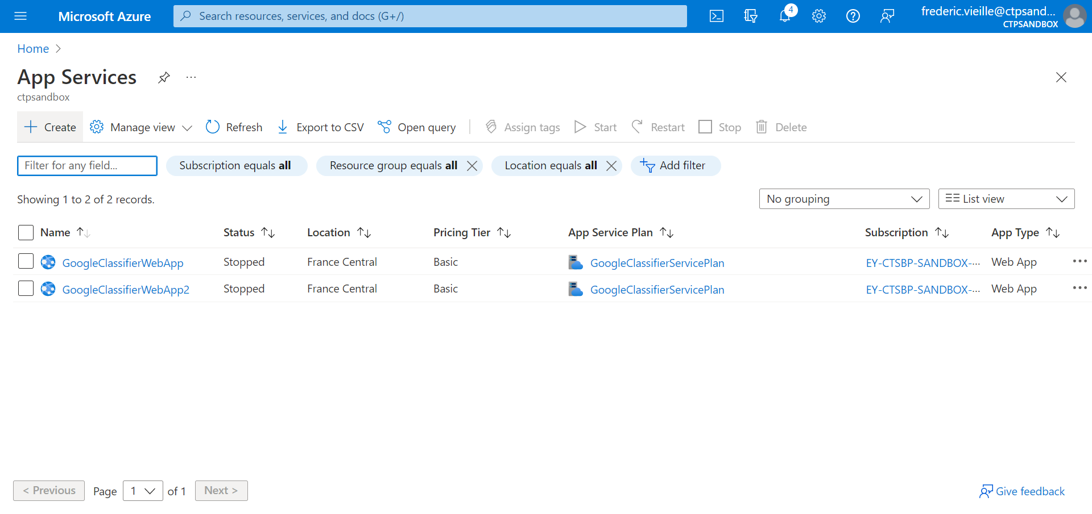
4- Create a Web App
Select + Create

Slide 17
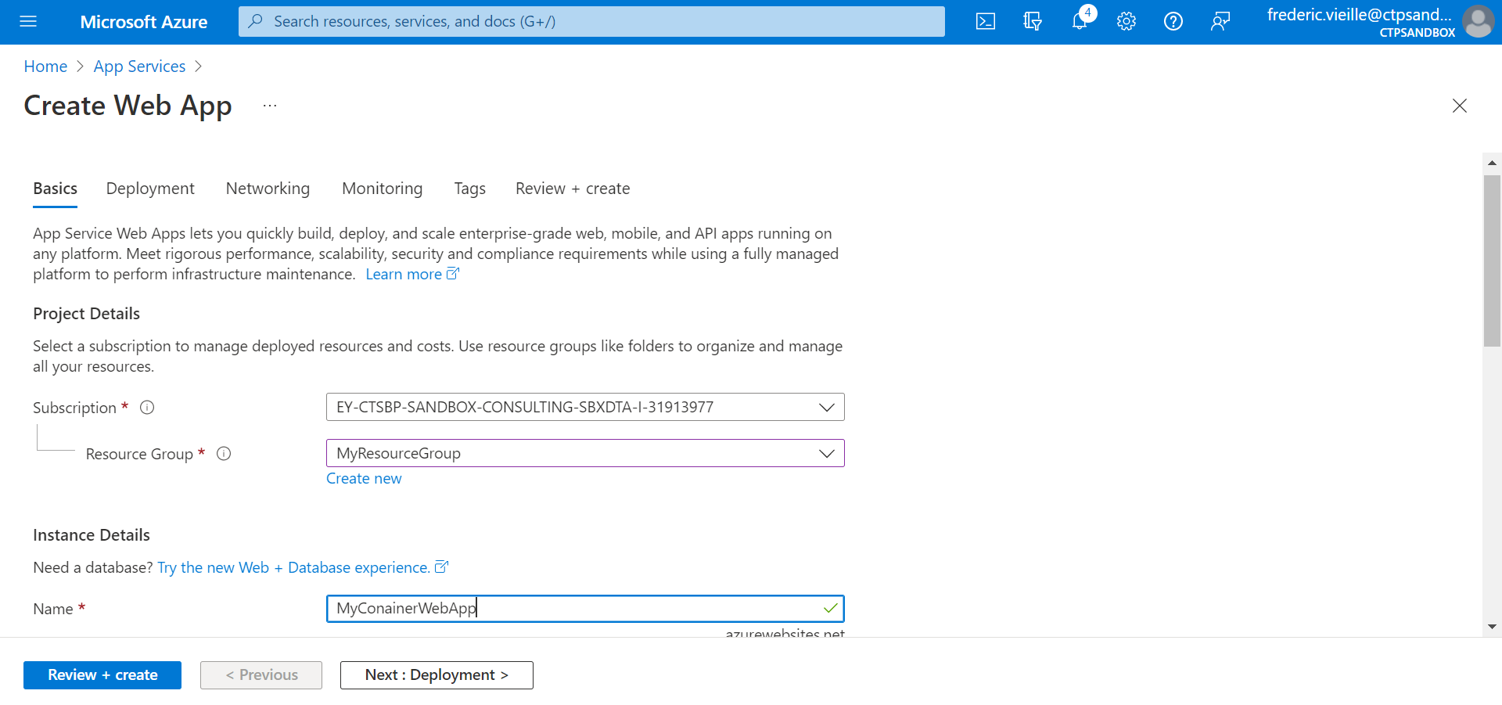
4- Create a Web App
Select your Azure Subscription
Select your previously created Resource Group
Enter a name for your Web App
Select Next : Deployment >

Slide 18
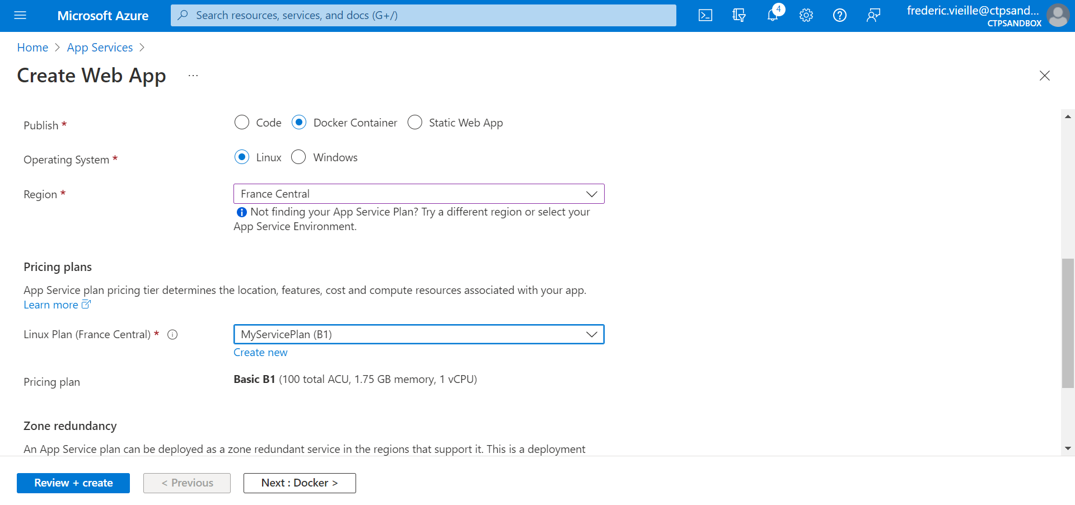
4- Create a Web App
Select Docker Container for Publish type
Select Linux as Operating System
Select the closest location
Select your previously created Service Plan
Select Next: Docker >

Slide 19
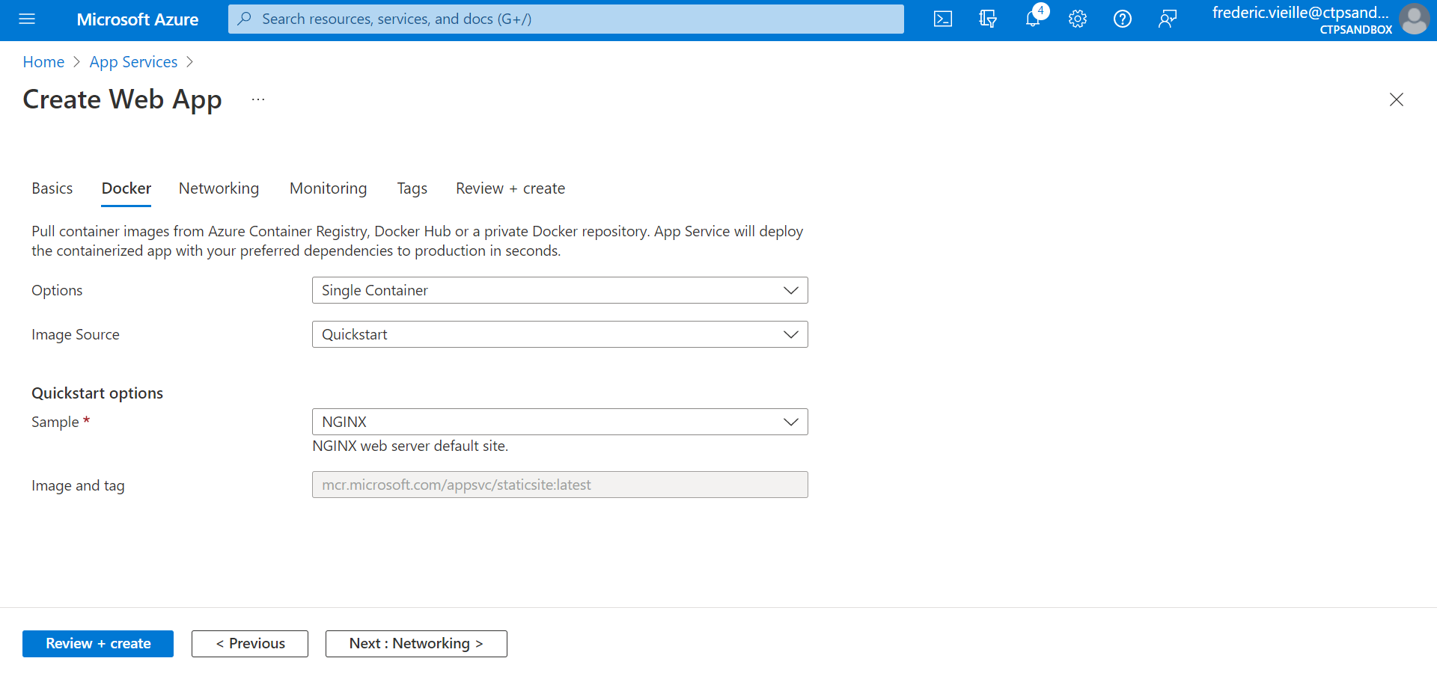
4- Create a Web App
Select Single Container in Options
Select the QuickStart image
Select Review + create

Slide 20
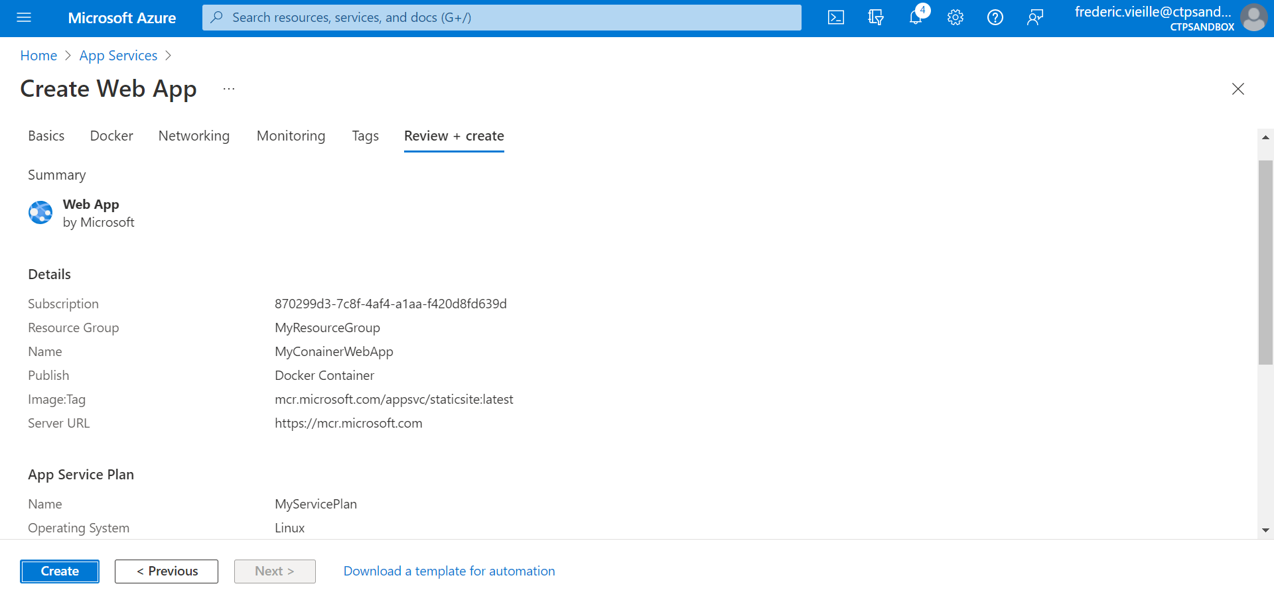
4- Create a Web App
Select Create

Slide 21
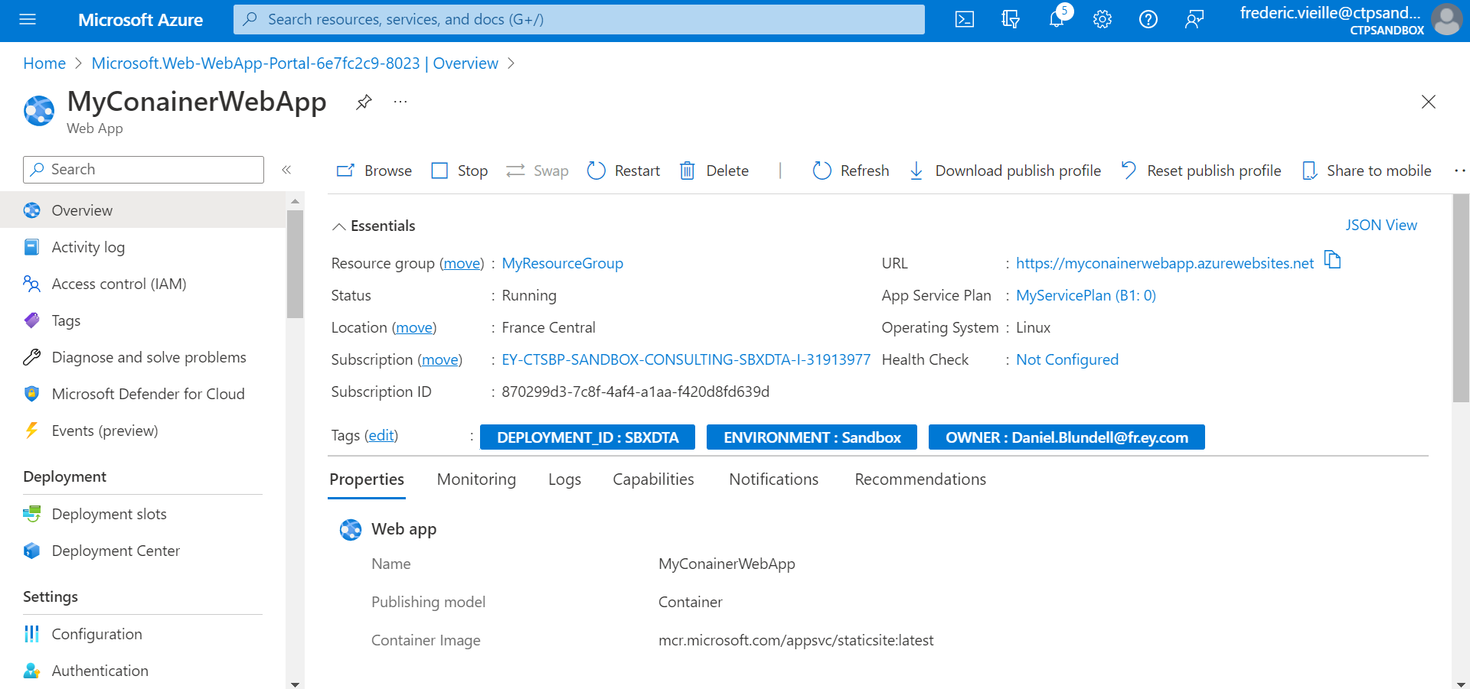
4- Create a Web App
Click the link in the URL section in the Overview page of your Web App to access your QuickStart App

Slide 22
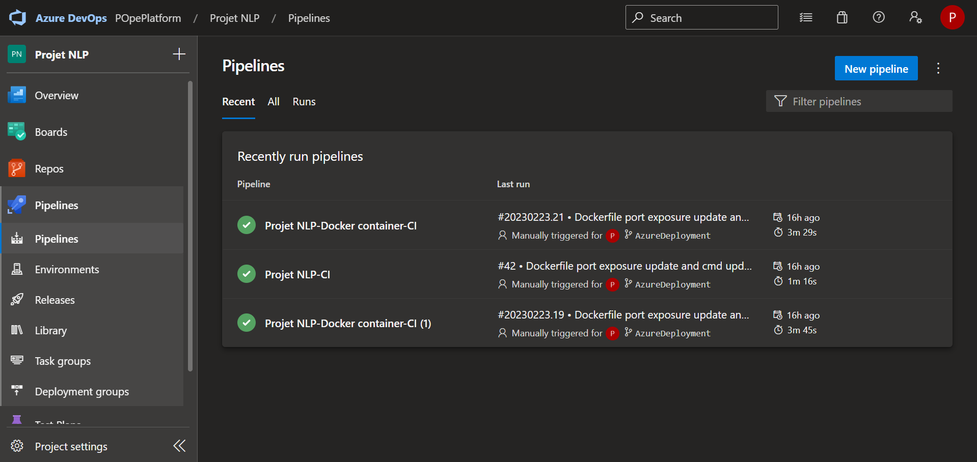
5- Create a Azure DevOps Pipeline
Open your Azure DevOps project
Select Pipelines in the left ribbon
Select New pipeline

Slide 23
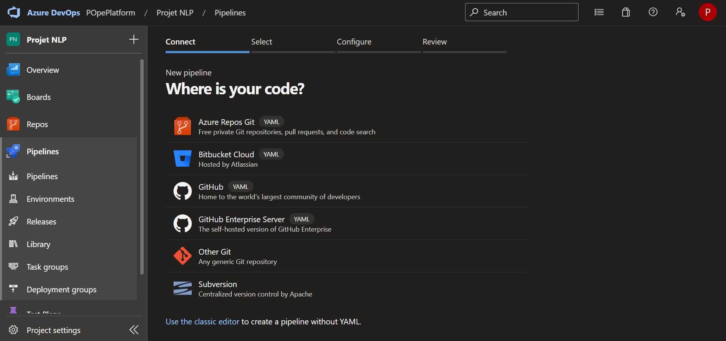
5- Create a Azure DevOps Pipeline
Select Use the classic editor

Slide 24
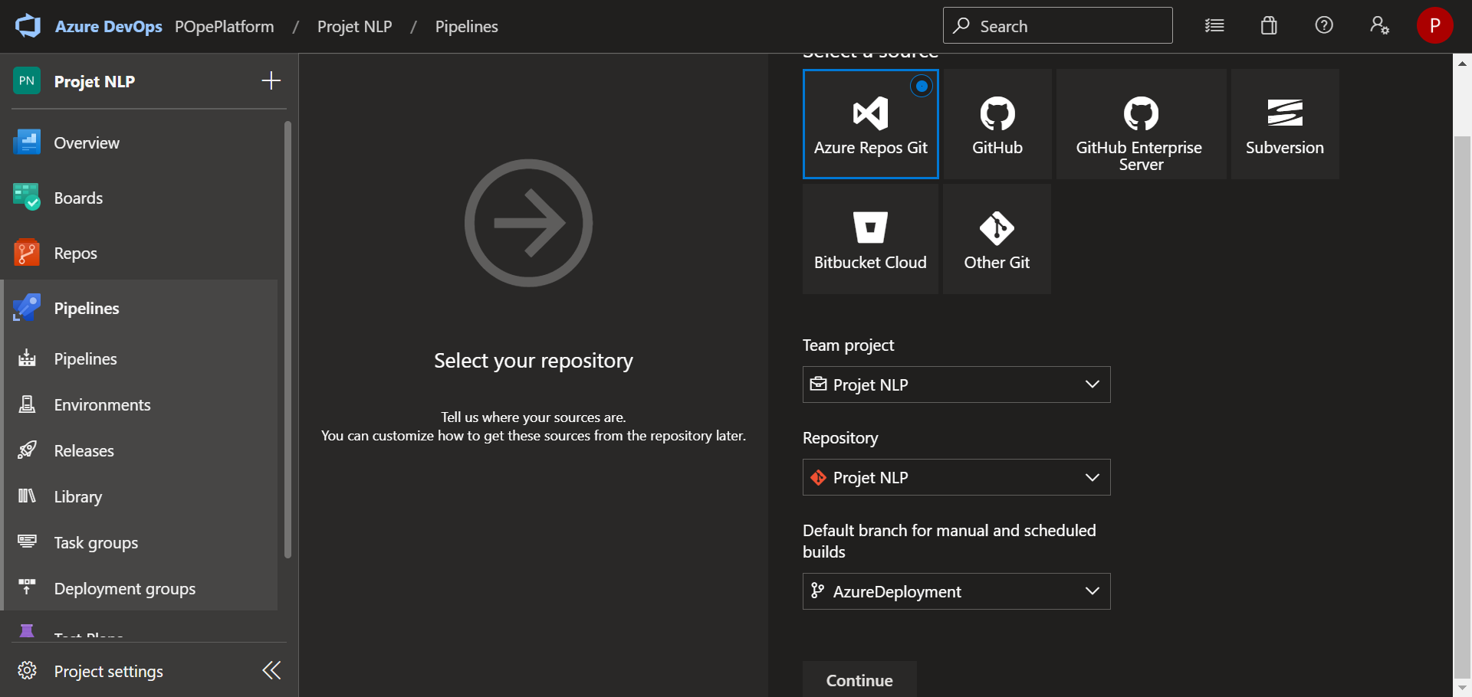
5- Create a Azure DevOps Pipeline
Select Azure Repos Git option
Select your Team project
Select your Repository
Select the Branch you want to create and deploy your continuous integration pipeline

Slide 25
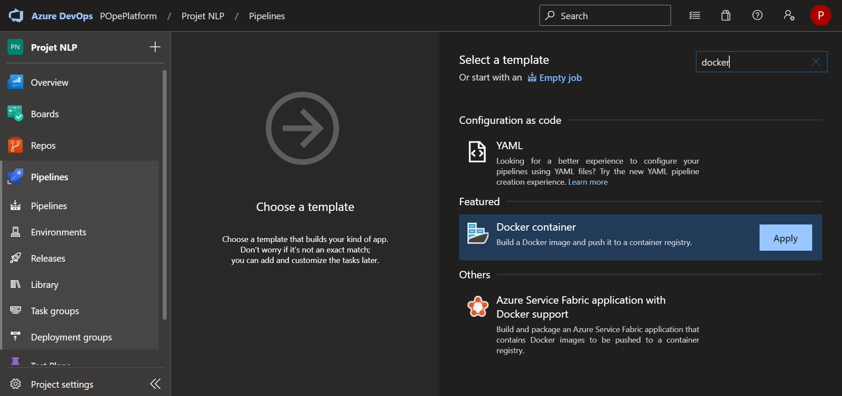
5- Create a Azure DevOps Pipeline
Enter docker in the search bar
Select and apply Docker container feature

Slide 26
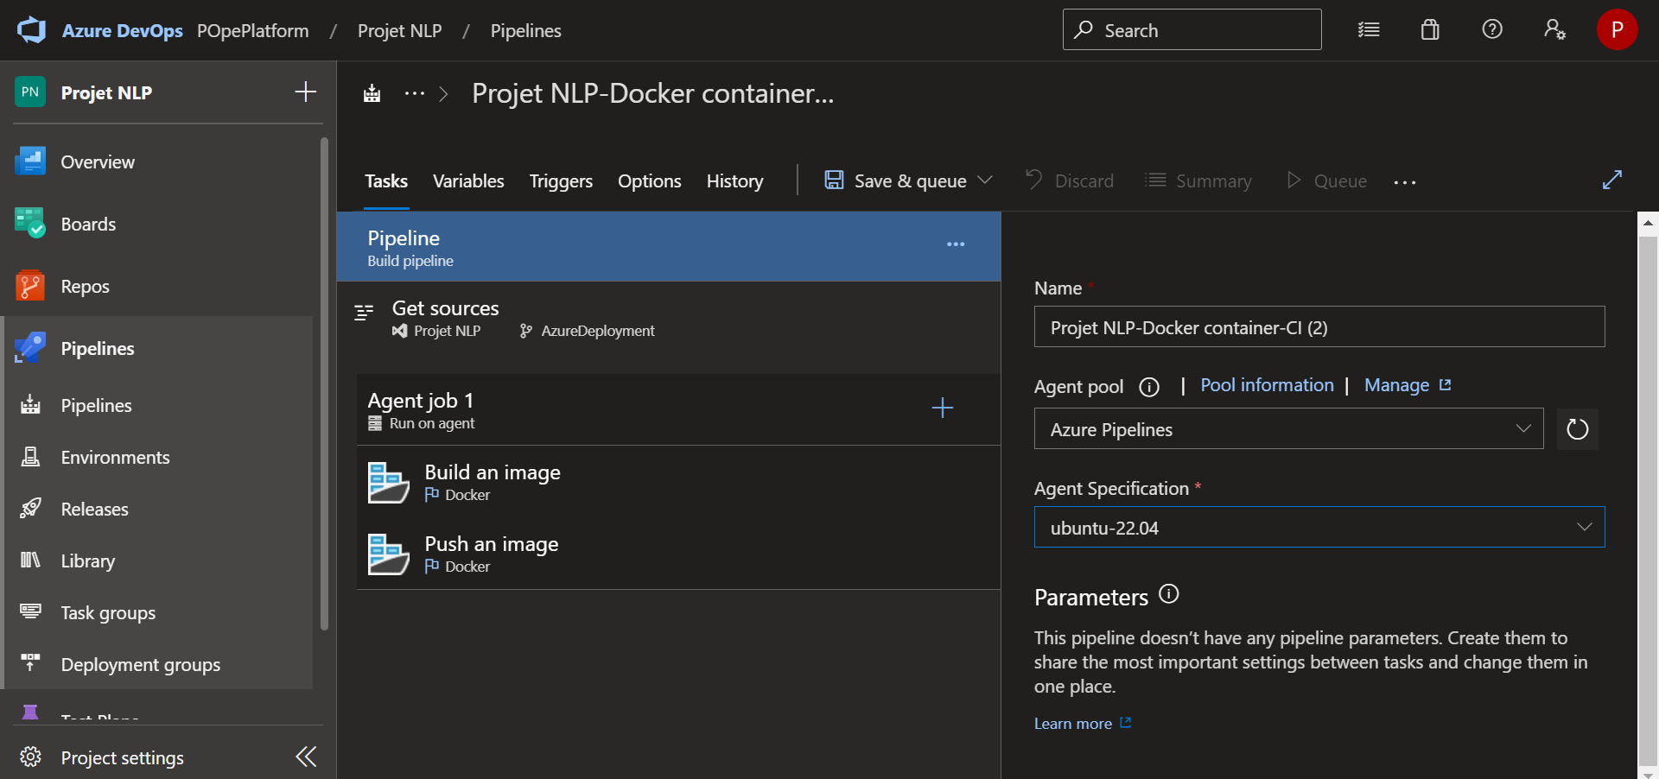
5- Create a Azure DevOps Pipeline
In the pipeline general settings
Enter a name for your pipeline
Choose Azure Pipelines as Agent pool
Select a Agent Specification (Ubuntu is recommended to follow this tutorial)

Slide 27
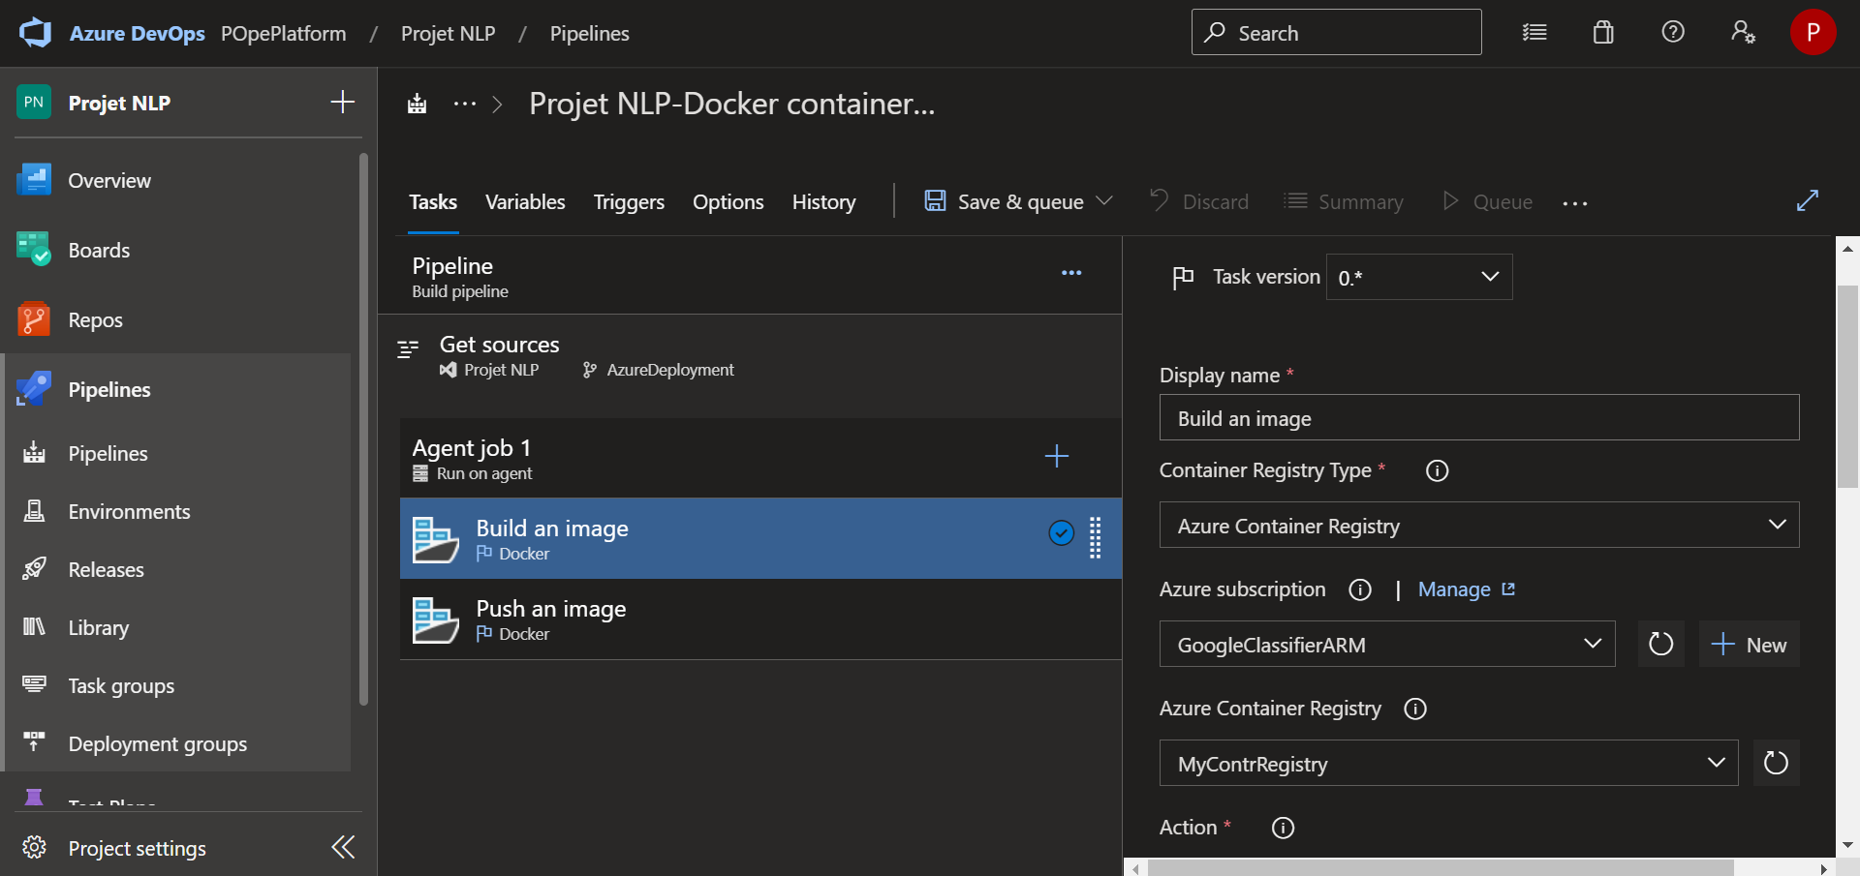
6- Docker Build Pipeline configuration
Select the first step of your pipeline Build an image
Check the Task version in order to have the same than this tutorial (this applies for every following steps of this tutorial pipeline configuration)
Select Azure Container Registry as Container Registry Type
Select your Azure Subscription
Select your previously created Azure Container Registry

Slide 28
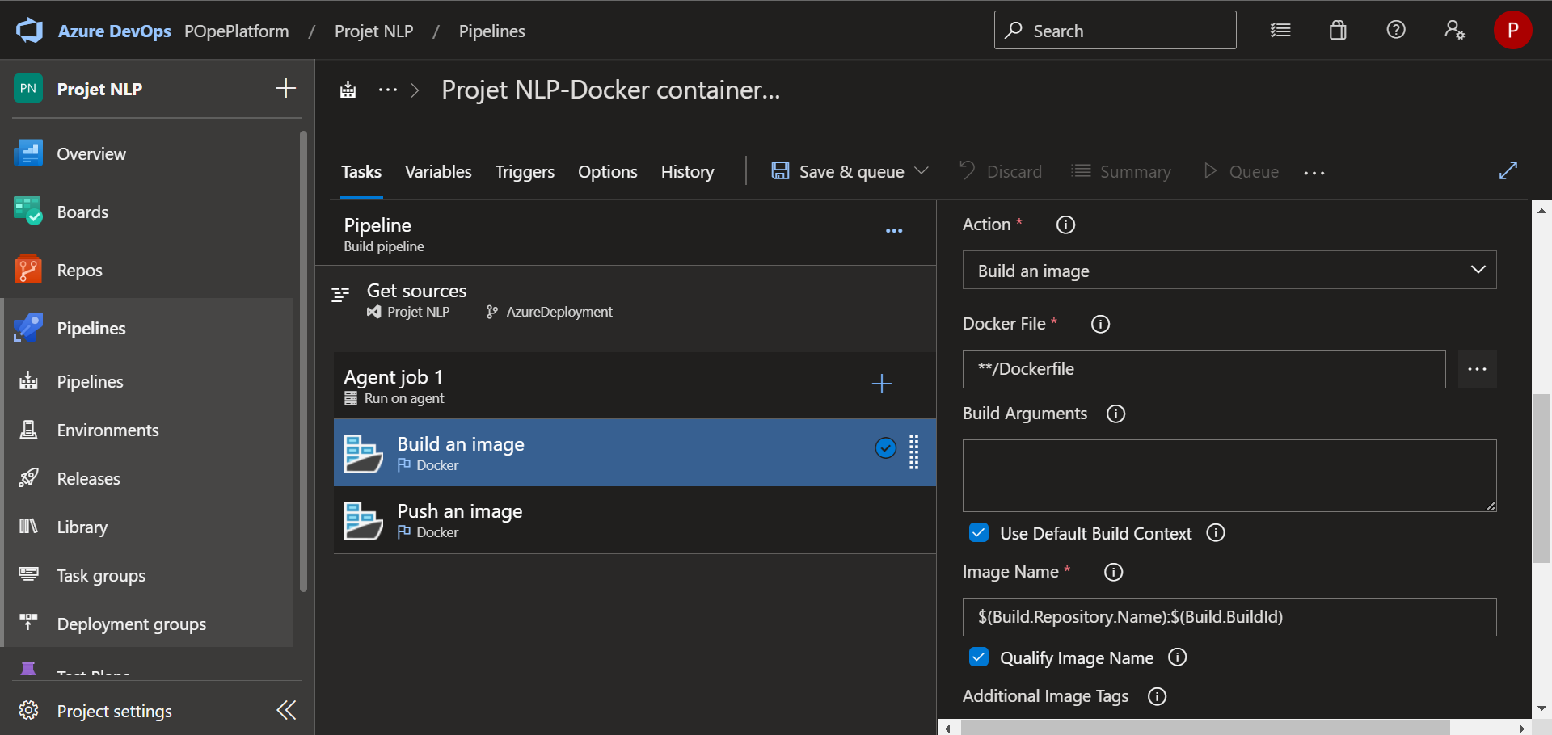
6- Docker Build Pipeline configuration
Check the Image Name and let the default value like on this example
Note : this value can be saved and used for a following step

Slide 29
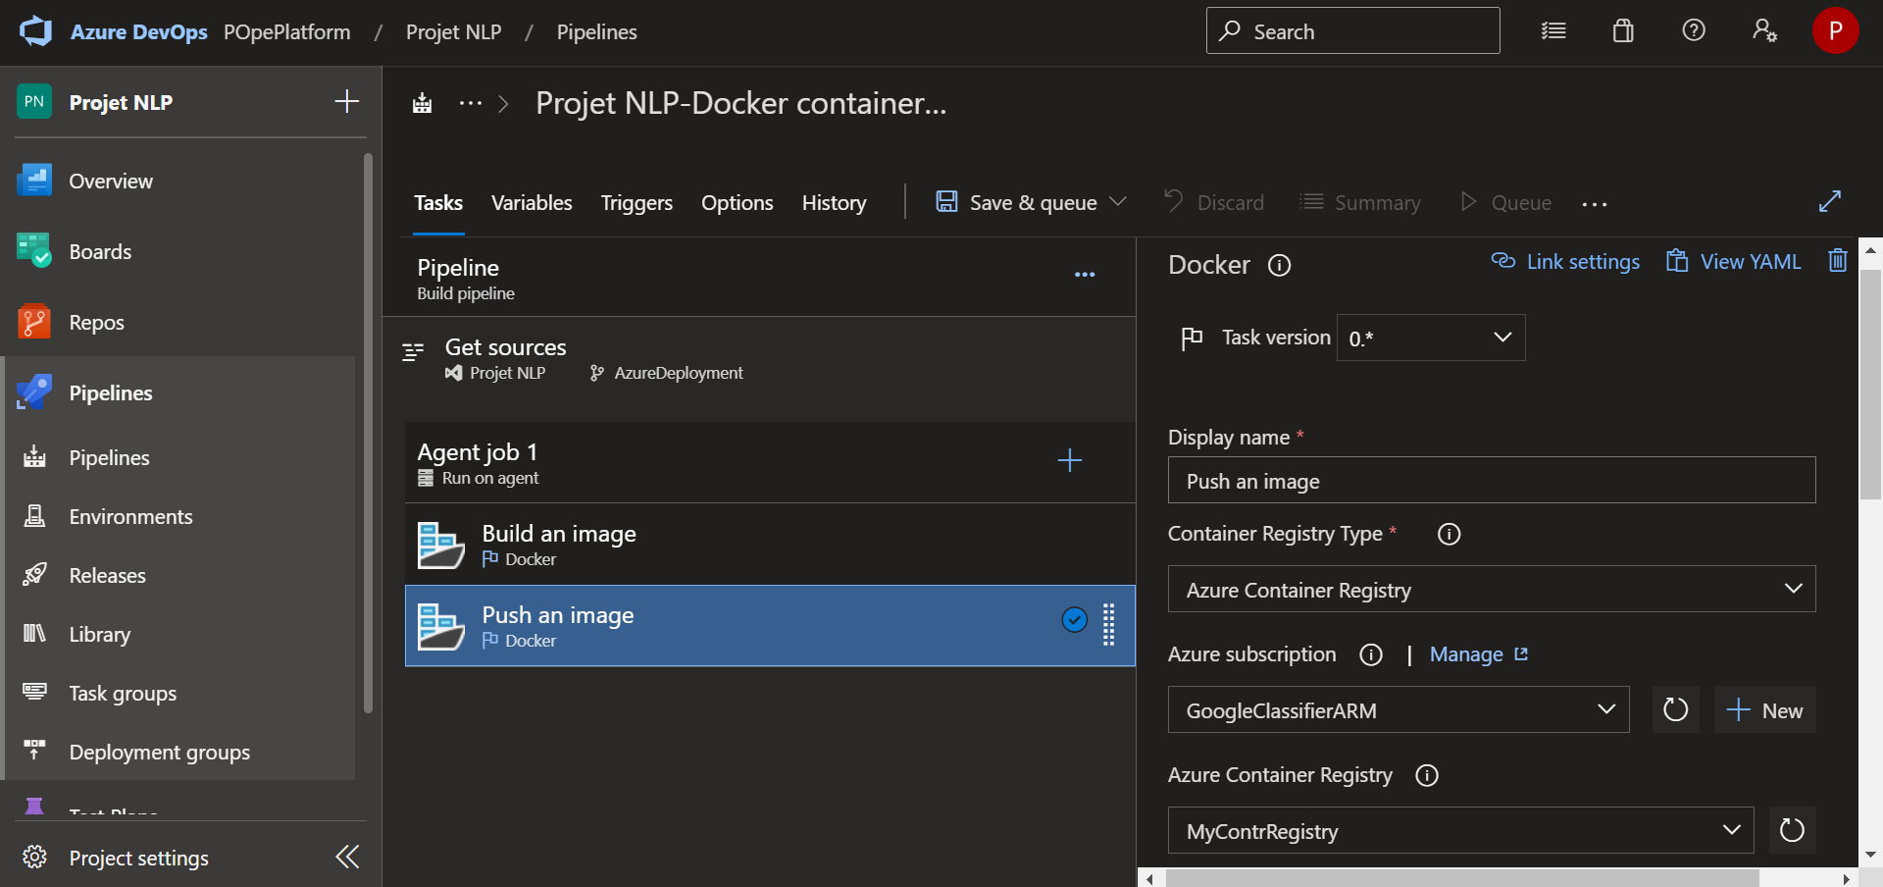
7- Docker Push Pipeline configuration
Select the Push an image step
Select Azure Container Registry as the Container Registry Type
Select your Azure Subscription
Select your previously created Azure Container Registry

Slide 30
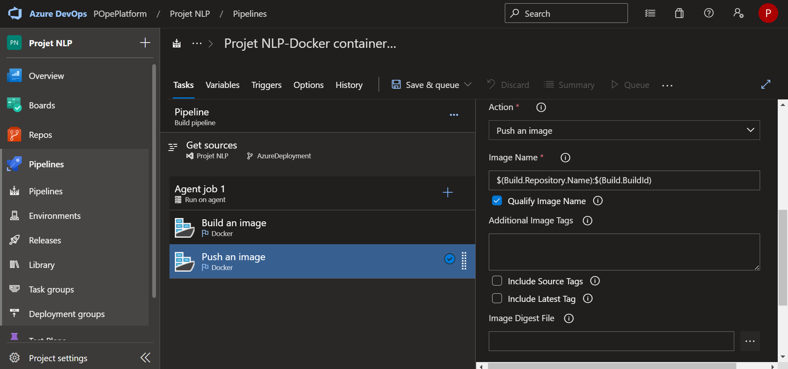
7- Docker Push Pipeline configuration
Check the Image Name and let the default value like on this example
Note : this value can be saved and used for a following step

Slide 31
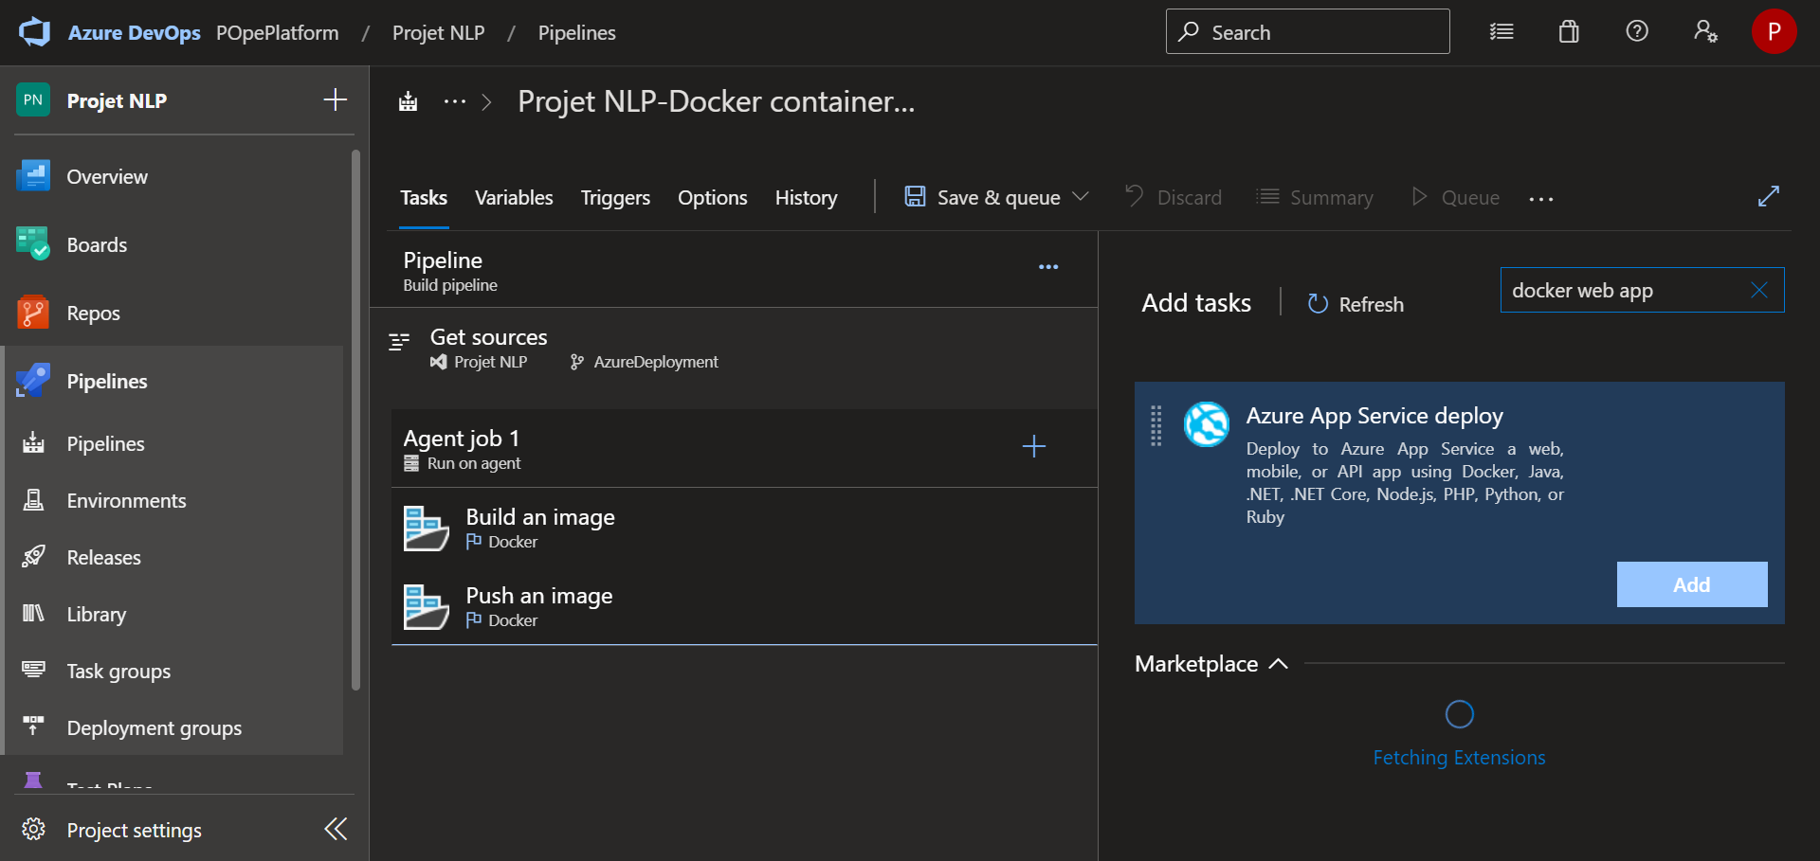
8- App Service Deployment Pipeline configuration
Select + to create a new step to your pipeline
Enter docker web app in the search bar
Choose and add an Azure App Service deploy step

Slide 32
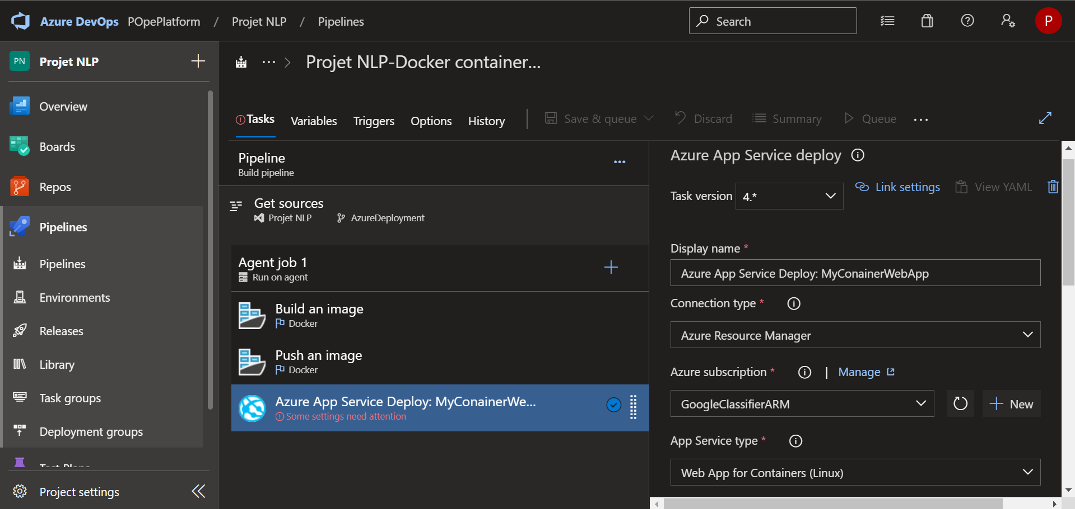
8- App Service Deployment Pipeline configuration
Select your Connection type. If you followed this connection service tutorial, select Azure Resource Manager
Select your Azure subscription. If you followed this connection service tutorial, select your previously created connection service
Select Web App for Containers (Linux) as the App Service type

Slide 33
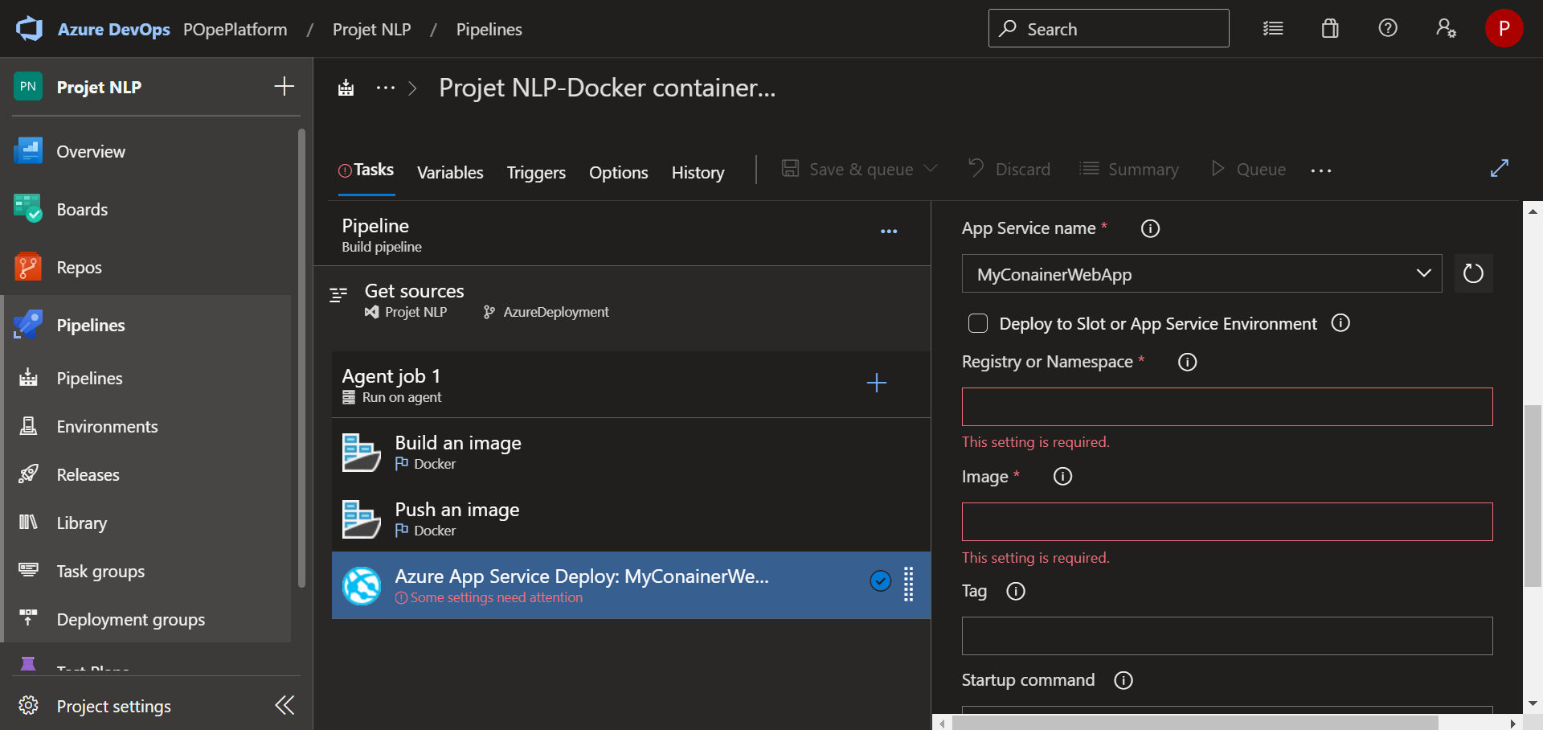
8- App Service Deployment Pipeline configuration
Select your previously created App Service
In order to get the Registry or Namespace information, we need to connect to the Azure Portal Sandbox.

Slide 34
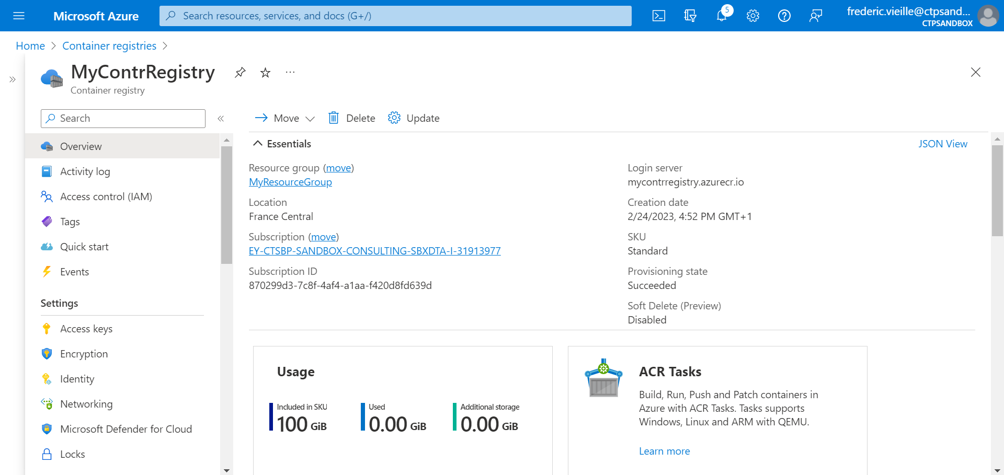
8- App Service Deployment Pipeline configuration
Go to your previously created Container registry
Note the value under Login server

Slide 35
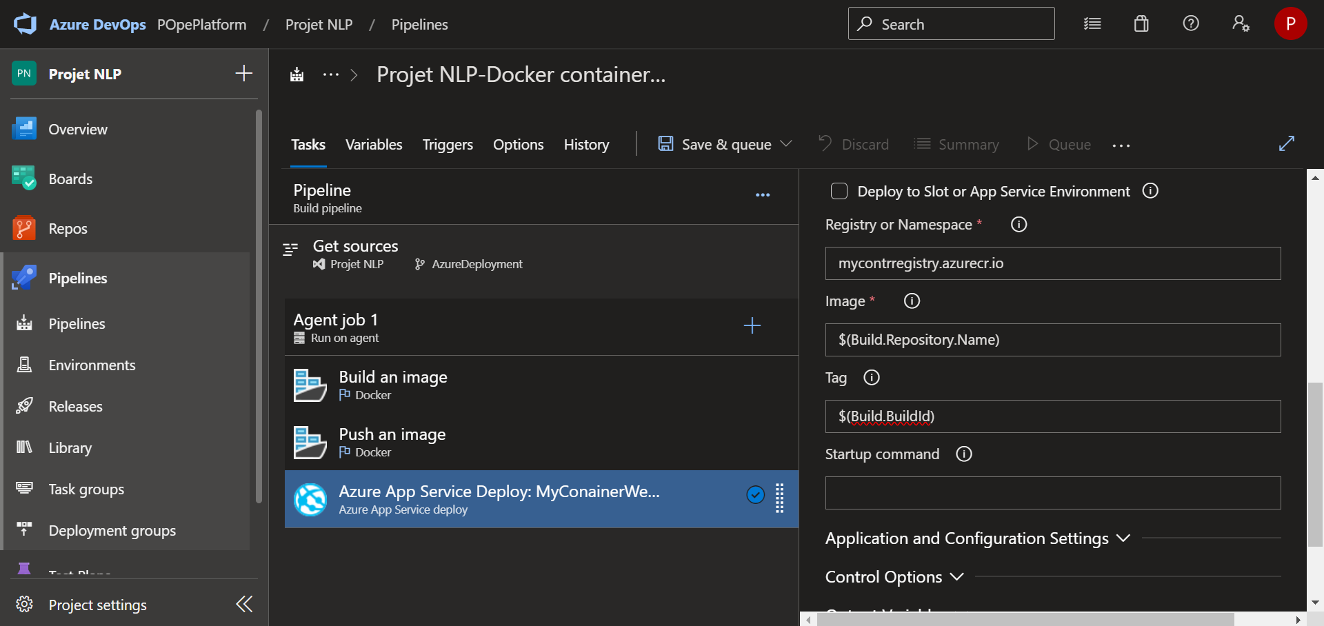
8- App Service Deployment Pipeline configuration
Go back to your Azure Devops pipeline form
Enter the Login server value in the Registry or Namespace field
In order to have a dynamically attribution of the right docker image and the right tag, we will choose the same values as the default Build and Push an image steps.
Enter $(Build.Repository.Name) for Image
Enter $(Build.BuildID) for Tag

Slide 36
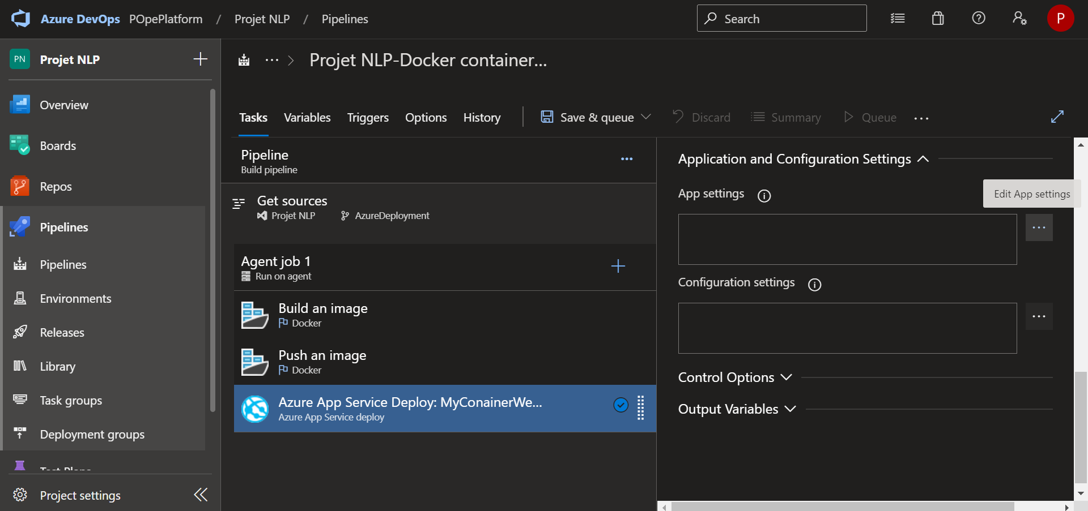
8- App Service Deployment Pipeline configuration
Scroll down and expand the Application and Configuration Settings section
Select the three dots button on App settings to edit the App settings
To get the right registry connections values, we have to go back to the Azure Portal Sandbox.

Slide 37
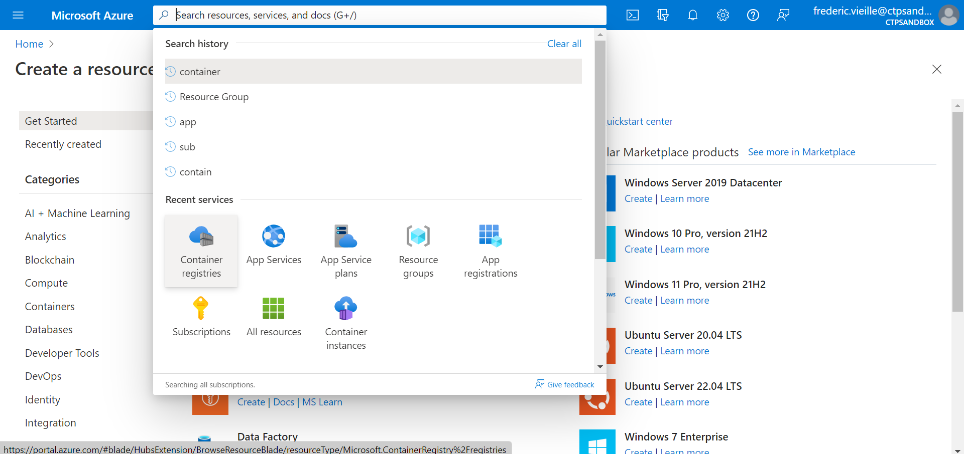
8- App Service Deployment Pipeline configuration
Go back to your Azure Portal Sandbox
Select Container registries from the search bar

Slide 38

8- App Service Deployment Pipeline configuration
Select your previously created Container Registry

Slide 39
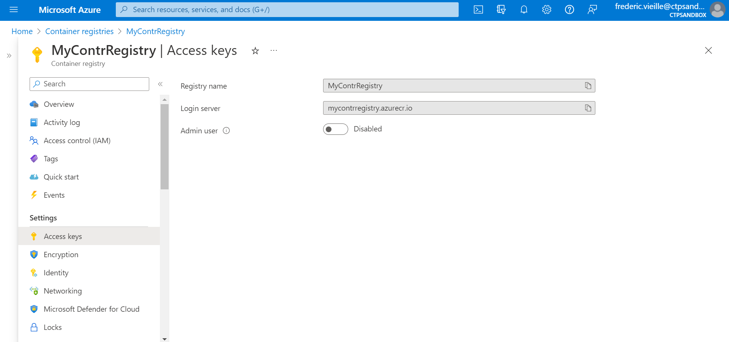
8- App Service Deployment Pipeline configuration
Select Access keys in the left ribbon
Check the Admin user checkbox in order to allow

Slide 40
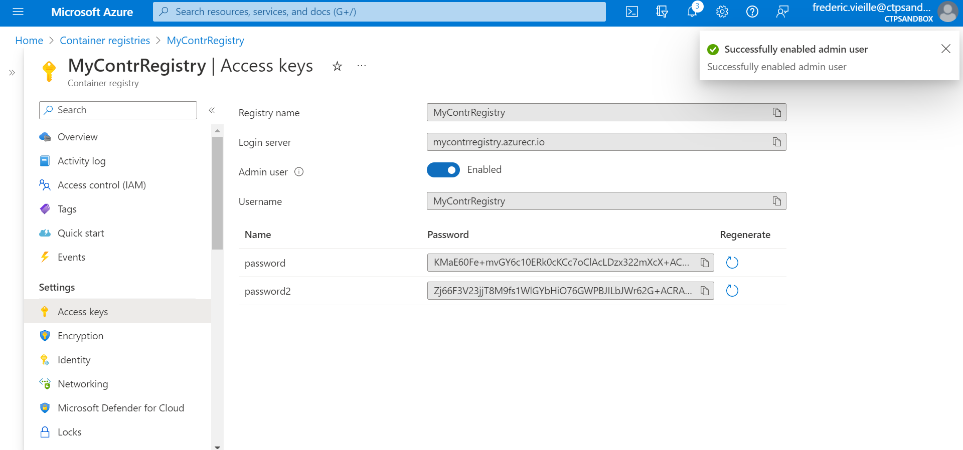
8- App Service Deployment Pipeline configuration
Note the following values :
Login server
Username
Password

Slide 41
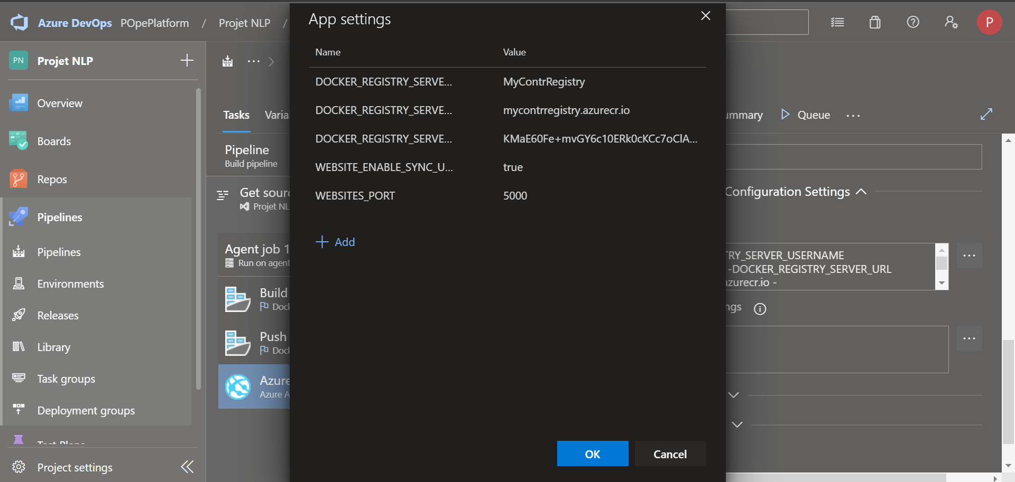
8- App Service Deployment Pipeline configuration
Enter the following fields in your App settings :
DOCKER_REGISTRY_SERVER_USERNAME : previous Username value
DOCKER_REGISTRY_SERVER_URL : previous Login server value
DOCKER_REGISTRY_SERVER_PASSWORD: previous Password value WEBSITE_ENABLE_SYNC_UPDATE_SITE : Enter value “true”
WEBSITES_PORT enter the exposed port from your Docker image

Slide 42
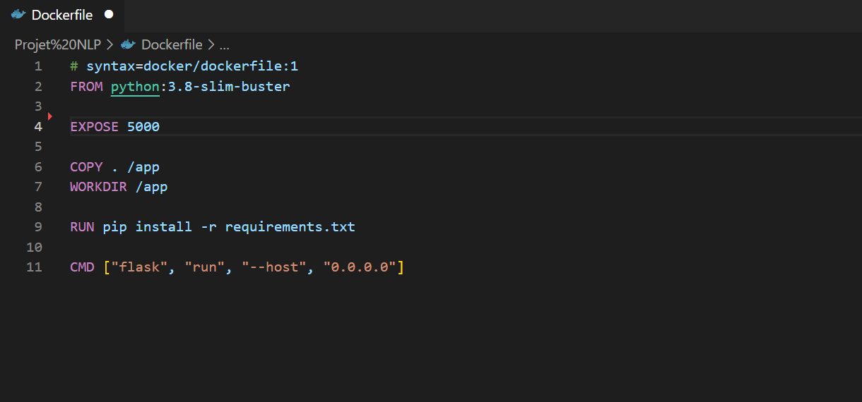
8- App Service Deployment Pipeline configuration
Make sure that you expose the port of your python web app in your Dockerfile (follow example)
Note : In the example of a flask app, the port 5000 is the default port.
Note : This port has to be entered as the WEBSITES_PORT value setting in your pipeline App Deployment step.

Slide 43
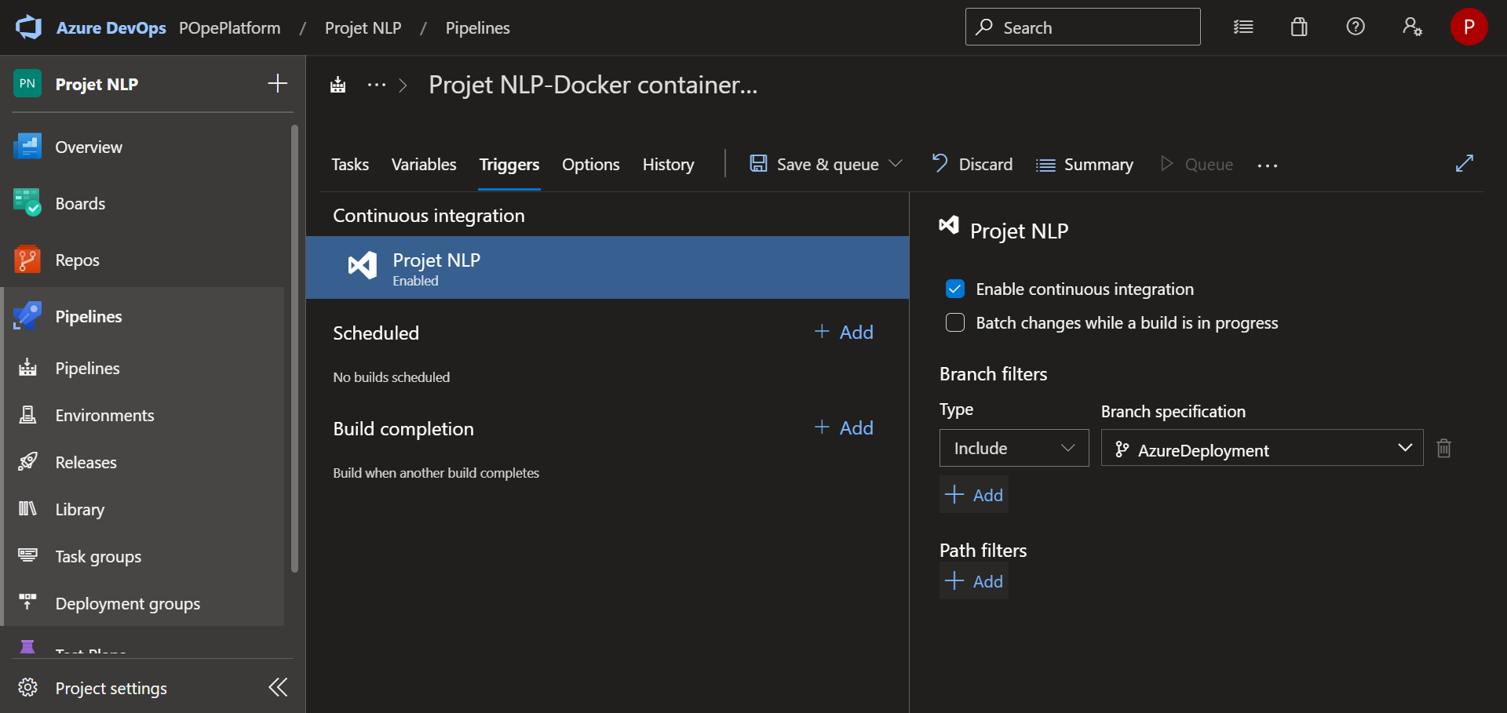
8- App Service Deployment Pipeline configuration
Select Triggers in the top ribbon
Check the Enable continuous integration option (this will automatically activate your pipeline at every git commit)
Select Save & queue

Slide 44
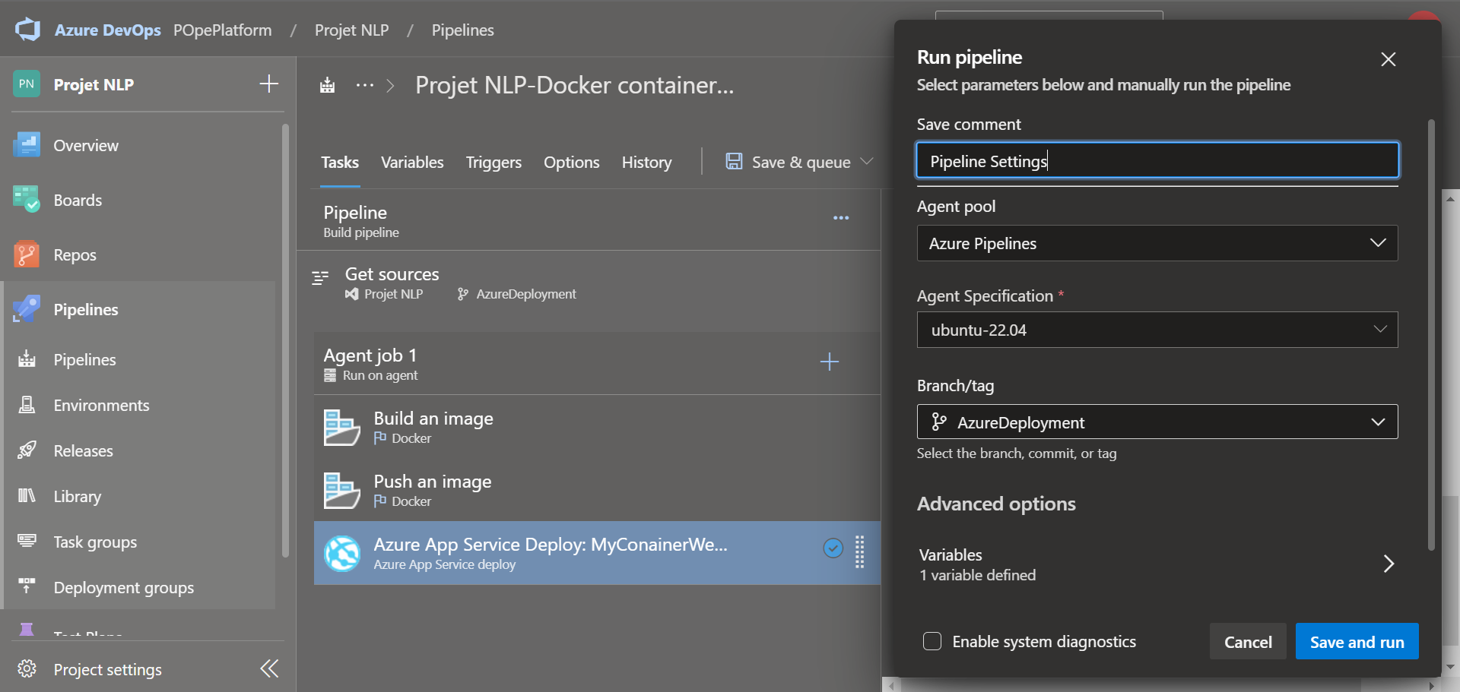
9- Run your Azure DevOps Pipeline
Enter a name for your pipeline modification
Check that you are using the right Agent Specification (Ubuntu recommended for this tutorial)
Select Save and run

Slide 45
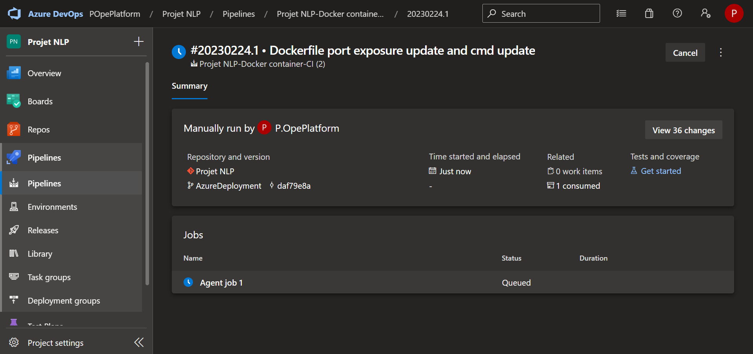
9- Run your Azure DevOps Pipeline
Select Agent job 1 to watch the logs of your running Pipeline

Slide 46
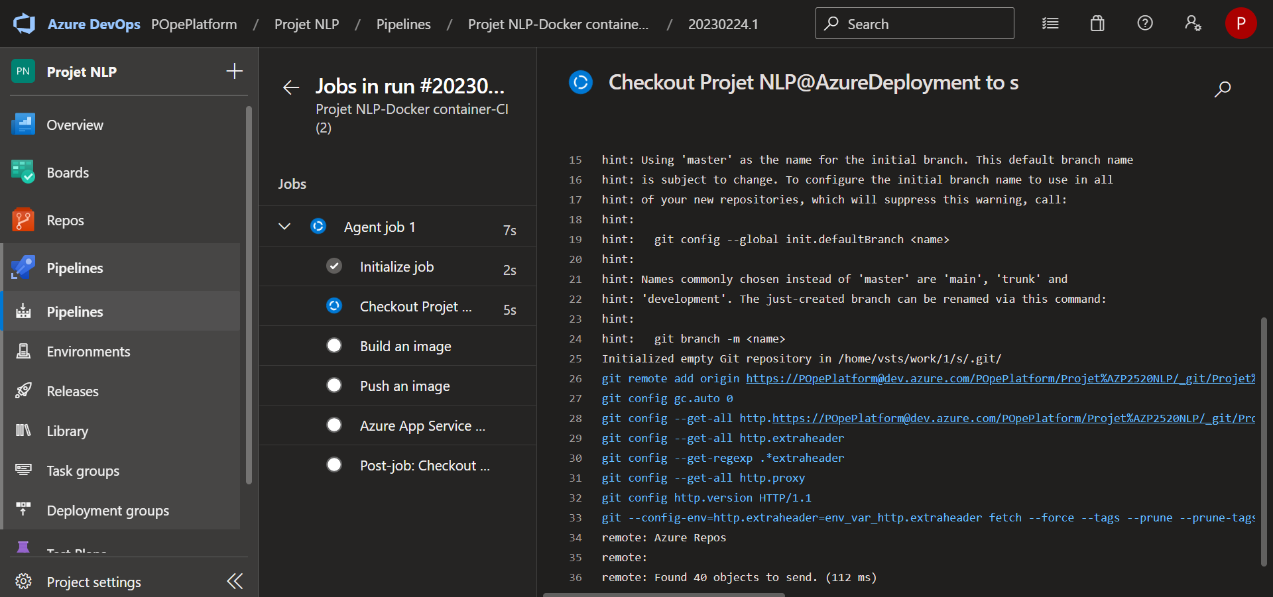
9- Run your Azure DevOps Pipeline
Here you can follow the logs and deployment from your Web App to your Azure Sandbox.

Slide 47
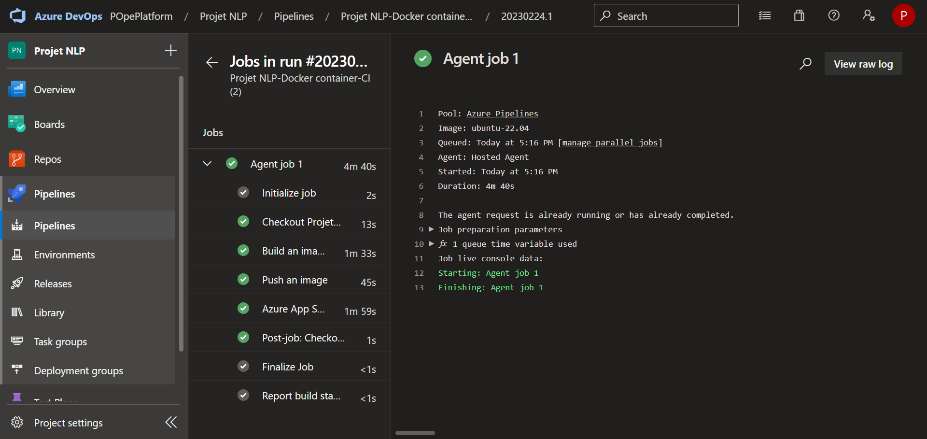
9- Run your Azure DevOps Pipeline
Congratulations ! You have deployed your new Web App thanks to continuous integration Pipeline.
Note 1 : If you have any errors, review the logs.

Slide 48
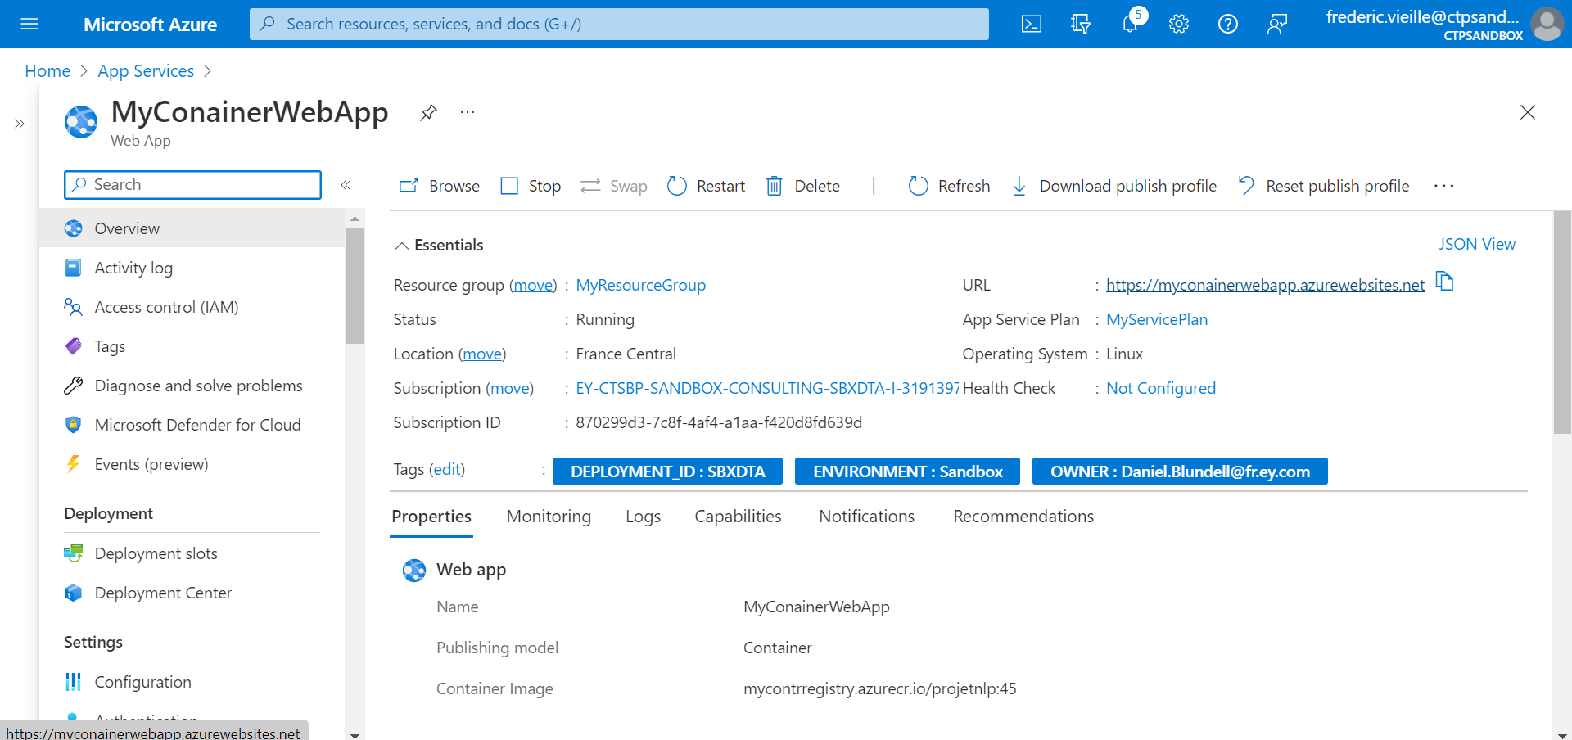
10- Run your Web App
Go back to the Azure Portal Sandbox
Select your Web App and click on the URL in the Overview section
You should see your webapp website after several minutes.

Slide 49
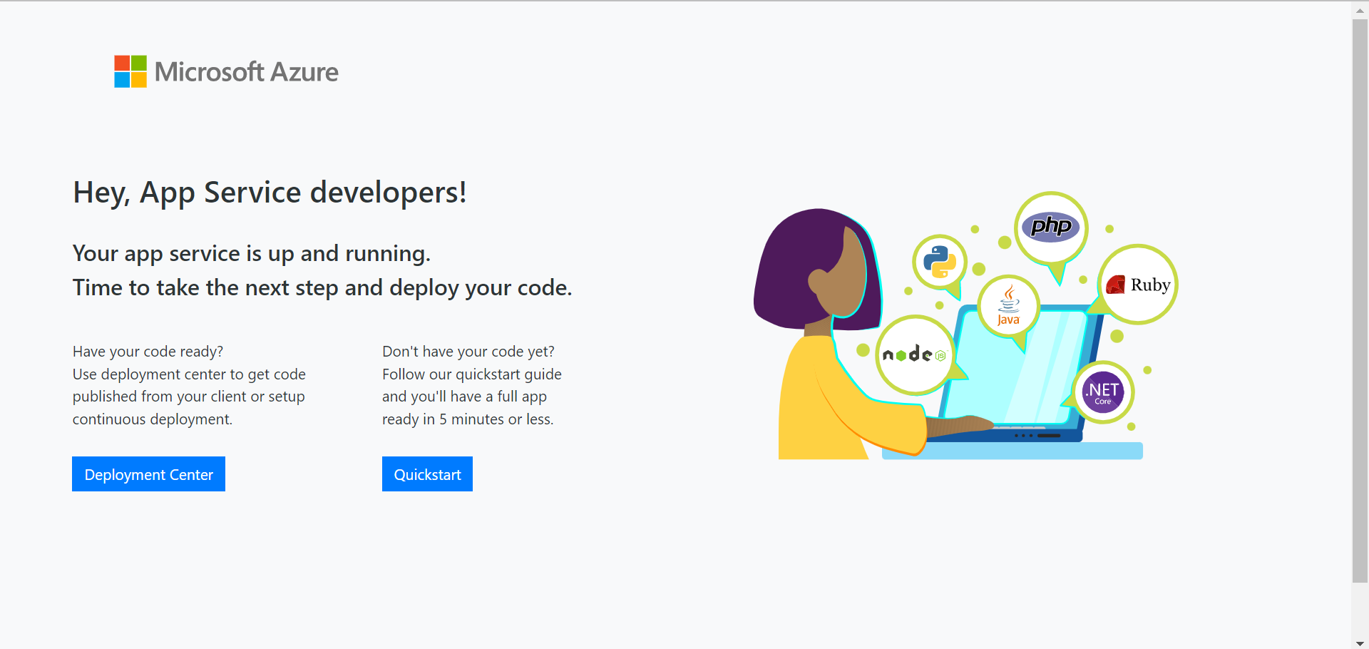
10- Run your Web App
If you still can’t see your web app try the following steps :
Delete and create your Web App again
This time choose your docker image from the Docker registry
Modify your Pipeline DevOps App settings in the deployment step and delete all the values but the WEBSITES_PORT setting (the other have will be already set by directly creating your Web App on top of your docker image

